Slide 1
Trinity Sunday
June 7, 2020
Rite Two: Sunday Worship
Using those portions allowed when Holy Communion is not available.

Slide 2
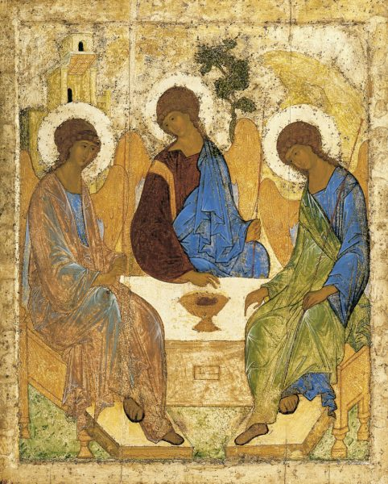

Slide 3
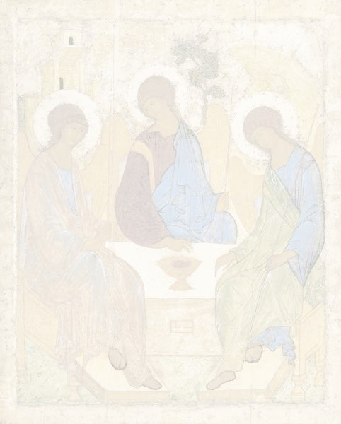
The Word of God
Celebrant Blessed be God: Father, Son, and Holy Spirit.
People And blessed be his kingdom,
now and for ever. Amen.
Celebrant Almighty God, to whom all hearts are open, all desires known, and from whom no secrets are hid: Cleanse the thoughts of our hearts by the inspiration of thy Holy Spirit, that we may perfectly love thee, and worthily magnify thy holy Name; through Christ our Lord. Amen.

Slide 4
A Song of Praise
Benedictus es, Domine
Song of the Three Young Men, 29-34
Glory to you, Lord God of our fathers,
you are worthy of praise; glory to you.
Glory to you for the radiance of your holy Name;
we will praise you and highly exalt you for ever.

Slide 5
Glory to you in the splendor of your temple;
on the throne of your majesty, glory to you.
Glory to you, seated between the Cherubim;
we will praise you and highly exalt you for ever.

Slide 6
Glory to you, beholding the depths;
in the high vault of heaven, glory to you.
Glory to you Father, Son, and Holy Spirit;
we will praise you and highly exalt you for ever.

Slide 7
The Collect for Trinity Sunday
Celebrant The Lord be with you.
People And with thy spirit.
Celebrant Let us pray. Almighty and everlasting God, you have given to us your servants grace, by the confession of a true faith, to acknowledge the glory of the eternal Trinity, and in the power of your divine Majesty to worship the Unity: Keep us steadfast in this faith and worship, and bring us at last to see you in your one and eternal glory, O Father; who with the Son and the Holy Spirit live and reign, one God, for ever and ever. Amen.

Slide 8
The First Lesson Genesis 1:1-2:4a
Lector A reading from Genesis.
In the beginning when God created the heavens and the earth, the earth was a formless void and darkness covered the face of the deep, while a wind from God swept over the face of the waters. Then God said, “Let there be light”; and there was light. And God saw that the light was good; and God separated the light from the darkness. God called the light Day, and the darkness he called Night. And there was evening and there was morning, the first day.

Slide 9
And God said, “Let there be a dome in the midst of the waters, and let it separate the waters from the waters.” So God made the dome and separated the waters that were under the dome from the waters that were above the dome. And it was so. God called the dome Sky. And there was evening and there was morning, the second day.

Slide 10
And God said, “Let the waters under the sky be gathered together into one place, and let the dry land appear.” And it was so. God called the dry land Earth, and the waters that were gathered together he called Seas. And God saw that it was good. Then God said, “Let the earth put forth vegetation: plants yielding seed, and fruit trees of every kind on earth that bear fruit with the seed in it.” And it was so. The earth brought forth vegetation: plants yielding seed of every kind, and trees of every kind bearing fruit with the seed in it. And God saw that it was good. And there was evening and there was morning, the third day.

Slide 11
And God said, “Let there be lights in the dome of the sky to separate the day from the night; and let them be for signs and for seasons and for days and years, and let them be lights in the dome of the sky to give light upon the earth.” And it was so. God made the two great lights—the greater light to rule the day and the lesser light to rule the night—and the stars. God set them in the dome of the sky to give light upon the earth, to rule over the day and over the night, and to separate the light from the darkness. And God saw that it was good. And there was evening and there was morning, the fourth day.

Slide 12
And God said, “Let the waters bring forth swarms of living creatures, and let birds fly above the earth across the dome of the sky.” So God created the great sea monsters and every living creature that moves, of every kind, with which the waters swarm, and every winged bird of every kind. And God saw that it was good. God blessed them, saying, “Be fruitful and multiply and fill the waters in the seas, and let birds multiply on the earth.” And there was evening and there was morning, the fifth day.

Slide 13
And God said, “Let the earth bring forth living creatures of every kind: cattle and creeping things and wild animals of the earth of every kind.” And it was so. God made the wild animals of the earth of every kind, and the cattle of every kind, and everything that creeps upon the ground of every kind. And God saw that it was good.

Slide 14
Then God said, “Let us make humankind in our image, according to our likeness; and let them have dominion over the fish of the sea, and over the birds of the air, and over the cattle, and over all the wild animals of the earth, and over every creeping thing that creeps upon the earth.”
So God created humankind in his image,
in the image of God he created them;
male and female he created them.

Slide 15
God blessed them, and God said to them, “Be fruitful and multiply, and fill the earth and subdue it; and have dominion over the fish of the sea and over the birds of the air and over every living thing that moves upon the earth.” God said, “See, I have given you every plant yielding seed that is upon the face of all the earth, and every tree with seed in its fruit; you shall have them for food. And to every beast of the earth, and to every bird of the air, and to everything that creeps on the earth, everything that has the breath of life, I have given every green plant for food.” And it was so. God saw everything that he had made, and indeed, it was very good. And there was evening and there was morning, the sixth day.

Slide 16
Thus the heavens and the earth were finished, and all their multitude. And on the seventh day God finished the work that he had done, and he rested on the seventh day from all the work that he had done. So God blessed the seventh day and hallowed it, because on it God rested from all the work that he had done in creation.
These are the generations of the heavens and the earth when they were created.
To conclude the Lector says
The Word of the Lord.
People Thanks be to God.

Slide 17
Gradual Domine, Dominus noster Psalm 8
1 O Lord our Governor, *
how exalted is your Name in all the world!
2 Out of the mouths of infants and children *
your majesty is praised above the heavens.
3 You have set up a stronghold against your adversaries, *
to quell the enemy and the avenger.

Slide 18
4 When I consider your heavens, the work of your fingers, *
the moon and the stars
you have set in their courses,
5 What is man that you should be mindful of him? *
the son of man that you should seek him out?
6 You have made him but little lower than the angels; *
you adorn him with glory and honor;

Slide 19
7 You give him mastery over the works of your hands; *
you put all things under his feet:
8 All sheep and oxen, *
even the wild beasts of the field,
9 The birds of the air, the fish of the sea, *
and whatsoever walks in the paths of the sea.
10 O Lord our Governor, *
how exalted is your Name in all the world!

Slide 20
The Second Lesson 2 Corinthians 13:11-13
Lector A reading from Paul’s second letter to the
Corinthians
Finally, brothers and sisters, farewell. Put things in order, listen to my appeal, agree with one another, live in peace; and the God of love and peace will be with you. Greet one another with a holy kiss. All the saints greet you.

Slide 21
The grace of the Lord Jesus Christ, the love of God, and the communion of the Holy Spirit be with all of you.
To conclude the Lector says
The Word of the Lord.
People Thanks be to God.

Slide 22
The Holy Gospel Matthew 28:16-20
The Deacon or a Priest reads the Gospel, first saying
The Holy Gospel of our Lord Jesus Christ
according to Matthew
People Glory be to thee, O Lord.
The eleven disciples went to Galilee, to the mountain to which Jesus had directed them. When they saw him, they worshiped him; but some doubted. And Jesus came and said to them, “All authority in heaven and on earth has been given to me.

Slide 23
Go therefore and make disciples of all nations, baptizing them in the name of the Father and of the Son and of the Holy Spirit, and teaching them to obey everything that I have commanded you. And remember, I am with you always, to the end of the age.”
After the Gospel, the Gospeler says
The Gospel of the Lord.
People Praise be to thee, O Christ.

Slide 24
The Sermon The Very Rev’d Daniel B. Brown

Slide 25
The Nicene Creed
We believe in one God, the Father, the Almighty,
maker of heaven and earth,
of all that is, seen and unseen.
We believe in one Lord, Jesus Christ,
the only Son of God, eternally begotten of the Father,
God from God, Light from Light,
true God from true God,
begotten, not made,
of one Being with the Father.

Slide 26
Through him all things were made.
For us and for our salvation
he came down from heaven:
by the power of the Holy Spirit he became incarnate from the Virgin Mary,
and was made man.
For our sake he was crucified
under Pontius Pilate;
he suffered death and was buried.

Slide 27
On the third day he rose again
in accordance with the Scriptures;
he ascended into heaven
and is seated at the right hand of the Father. He will come again in glory
to judge the living and the dead,
and his kingdom will have no end.

Slide 28
We believe in the Holy Spirit,
the Lord, the giver of life, who proceeds from the Father and the Son. With the Father and the Son
he is worshiped and glorified.
He has spoken through the Prophets.

Slide 29
We believe in one holy catholic
and apostolic Church.
We acknowledge one baptism
for the forgiveness of sins.
We look for the resurrection of the dead,
and the life of the world to come. Amen.

Slide 30
The Prayers of the People
Celebrant Let us pray for the whole state of Christ’s church and the world.

Slide 31
Almighty and everliving God, who in thy holy Word hast taught us to make prayers, and supplications, and to give thanks for all men: Receive these our prayers which we offer unto thy divine Majesty, beseeching thee to inspire continually the Universal Church with the spirit of truth, unity, and concord; and grant that all those who do confess thy holy Name may agree in the truth of thy holy Word, and live in unity and godly love.

Slide 32
Give grace, O heavenly Father, to all bishops and other ministers especially Michael our Presiding Bishop; Rob, Don and Paul our Bishops; Neil and Keith our Bishops retired, that they may, both by their life and doctrine, set forth thy true and lively Word, and rightly and duly administer thy holy Sacraments.

Slide 33
And to all thy people give thy heavenly grace, and especially to this congregation here present; that, with meek heart and due reverence, they may hear and receive thy holy Word, truly serving thee in holiness and righteousness all the days of their life.

Slide 34
We beseech thee also so to rule the hearts of those who bear the authority of government in this and every land especially Donald our President, Brian our Governor, Fred our Mayor and Philip our County Commission Chairman, that they may be led to wise decisions and right actions for the welfare and peace of the world.

Slide 35
Open, O Lord, the eyes of all people to behold thy gracious hand in all thy works, that, rejoicing in thy whole creation, they may honor thee with their substance, and be faithful stewards of thy bounty.

Slide 36
And we most humbly beseech thee, of thy goodness, O Lord, to comfort and succor Carol Blow, HD Cannington, Dan Jubelt, Bob Lyle, Jane Symmes, and Pat Wells and all those who, in this transitory life, are in trouble, sorrow, need, sickness, or any other adversity.

Slide 37
Almighty God, we beseech thee to grant strength and courage to all medical and emergency staff serving those suffering COVID-19 infections and to bring wisdom and patience to us all as we shelter in place and guard God’s beloved creation from further spread of the Corona virus.

Slide 38
In the Anglican Communion we pray for La Iglesia Anglicana de Mexico, The Most Rev’d Francisco Moreno - Presiding Bishop of La Iglesia Anglicana de Mexico & Bishop of Northern Mexico.

Slide 39
In our Diocese of Atlanta we pray for the clergy and people of Church of the Holy Trinity, Decatur; Trinity, Columbus, St. Columba's, Suwanee; St. Barnabas, Trion; St. Anthony's, Winder; for the East Atlanta Convocation; for all congregations seeking new or renewed direction and we pray for the Bishop and people of our companion and partner, the Diocese of Cape Coast.

Slide 40
We pray for Doug Adkins and our Parish Committee on Ministry: Terry Blum, OJ Booker, Rick Crown, and Anna Marett.

Slide 41
We pray for those celebrating birthdays or anniversaries especially Naomi Thompson, Sue Baldwin and Elizabeth Branch.

Slide 42
And we also bless thy holy Name for all thy servants departed this life in thy faith and fear, beseeching thee to grant them continual growth in thy love and service; and to grant us grace so to follow the good examples of the ever-blessed Virgin Mary, dear John the Baptist and of all thy saints, that with them we may be partakers of thy heavenly kingdom.

Slide 43
Grant these our prayers, O Father, for Jesus Christ’s sake, our only Mediator and Advocate. Amen.

Slide 44
Celebrant Let us humbly confess our sins unto Almighty God.
Silence may be kept.
All Most merciful God,
we confess that we have sinned against thee
in thought, word, and deed, by what we have done, and by what we have left undone. We have not loved thee with our whole heart;
we have not loved our neighbors as ourselves.
We are truly sorry and we humbly repent.

Slide 45
For the sake of thy Son Jesus Christ,
have mercy on us and forgive us;
that we may delight in thy will,
and walk in thy ways,
to the glory of thy Name. Amen.

Slide 46
May Almighty God in mercy receive our confession of sorrow and of faith, through Jesus Christ our Lord strengthen us in all goodness, and by the power of the Holy Spirit keep us in eternal life. Amen.

Slide 47
Celebrant And now in the words our Savior taught us
we are bold to say,
Our Father, who art in heaven,
hallowed be thy Name, thy kingdom come, thy will be done,
on earth as it is in heaven.
Give us this day our daily bread.
And forgive us our trespasses,
as we forgive those who trespass against us.
And lead us not into temptation,
but deliver us from evil. For thine is the kingdom,
and the power, and the glory,
for ever and ever. Amen.

Slide 48
May the God who created you, bless you with discomfort
At easy answers, half-truths, and superficial relationships
So that you may live from deep within your heart. Amen.

Slide 49
May God who redeemed you in Christ, bless you with anger at injustice, oppression, and the exploitation of others, so that you may work for righteousness, freedom and peace. Amen.

Slide 50
May God whose Holy Ghost sanctifies you, now bless you with tears to shed for those who suffer pain, rejection, hunger and sorrow, So that you may reach out to comfort them and to turn their pain into joy. Amen.

Slide 51
And may God, the holy and undivided Trinity bless you with enough foolishness to believe that you can make a difference in the world. To do what others claim cannot be done and bring justice, kindness and the abundance of shalom to all God’s creation. Amen.

Slide 52
The Dismissal
Deacon Let us go forth into the world
rejoicing in the power of the spirit.
People Thanks be to God.

Slide 53
The Peace
Celebrant The peace of the Lord be always with you.
People And with thy spirit.

