Slide 1
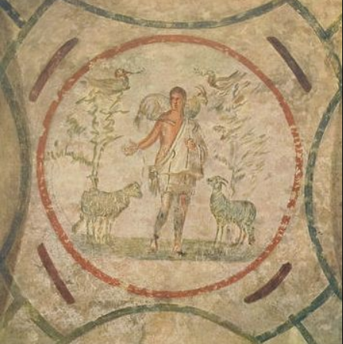

Slide 3
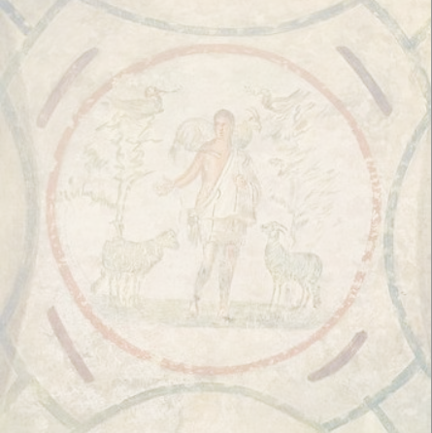
Rite Two: Sunday Worship
Using those portions allowed when Holy Communion is not available.
May 3, 2020
Church of the Advent
Madison Georgia

Slide 4
The Word of God
Celebrant Alleluia. Christ is risen.
People The Lord is risen indeed. Alleluia.
Celebrant Almighty God, to you all hearts are open, all desires known, and from you no secrets are hid: Cleanse the thoughts of our hearts by the inspiration of your Holy Spirit, that we may perfectly love you, and worthily magnify your holy Name; through Christ our Lord. Amen.

Slide 5
Christ our Passover (in unison)
Alleluia.
Christ our Passover is sacrificed for us,
therefore let us keep the feast, Not with old leaven, neither with the leaven
of malice and wickedness,
but with the unleavened bread
of sincerity and truth. Alleluia.

Slide 6
Christ being raised from the dead
dieth no more;
death hath no more dominion over him.
For in that he died,
he died unto sin once;
but in that he liveth,
he liveth unto God.
Likewise reckon ye also yourselves
to be dead indeed unto sin,
but alive unto God
through Jesus Christ our Lord. Alleluia.

Slide 7
Christ is risen from the dead, and become the first fruits
of them that slept.
For since by man came death, by man came also the resurrection of the dead.
For as in Adam all die, even so in Christ
shall all be made alive. Alleluia.

Slide 8
The Collect for the Fourth Sunday of Easter
Celebrant The Lord be with you.
People And also with you.
Celebrant Let us pray.
O God, whose Son Jesus is the good shepherd of your people: Grant that when we hear his voice we may know him who calls us each by name, and follow where he leads; who, with you and the Holy Spirit, lives and reigns, one God, for ever and ever. Amen.

Slide 9
The Lessons
The Acts of the Apostles 2:42-47
Lector A Reading from The Acts of the Apostles
Those who had been baptized devoted themselves to the apostles' teaching and fellowship, to the breaking of bread and the prayers.

Slide 10
Awe came upon everyone, because many wonders and signs were being done by the apostles. All who believed were together and had all things in common; they would sell their possessions and goods and distribute the proceeds to all, as any had need.

Slide 11
Day by day, as they spent much time together in the temple, they broke bread at home and ate their food with glad and generous hearts, praising God and having the goodwill of all the people. And day by day the Lord added to their number those who were being saved.
To conclude the Lector says
The Word of the Lord.
People Thanks be to God.

Slide 12
Gradual Psalm Dominus regit me Psalm 23
1 The Lord is my shepherd; * I shall not be in want.
2 He makes me lie down in green pastures * and leads me beside still waters.

Slide 13
3 He revives my soul * and guides me along right pathways
for his Name's sake.
4 Though I walk through the valley
of the shadow of death, I shall fear no evil; * for you are with me; your rod and your staff, they comfort me.

Slide 14
5 You spread a table before me
in the presence of those who trouble me; * you have anointed my head with oil, and my cup is running over.
6 Surely your goodness and mercy shall follow me
all the days of my life, * and I will dwell in the house
of the Lord for ever

Slide 15
The Second Lesson 1 Peter 2:19-25
Lector A Reading from the First letter of Peter
It is a credit to you if, being aware of God, you endure pain while suffering unjustly. If you endure when you are beaten for doing wrong, what credit is that? But if you endure when you do right and suffer for it, you have God's approval. For to this you have been called, because Christ also suffered for you, leaving you an example, so that you should follow in his steps.

Slide 16
“He committed no sin, and no deceit was found in his mouth.”
When he was abused, he did not return abuse; when he suffered, he did not threaten; but he entrusted himself to the one who judges justly. He himself bore our sins in his body on the cross, so that, free from sins, we might live for righteousness; by his wounds you have been healed.

Slide 17
For you were going astray like sheep, but now you have returned to the shepherd and guardian of your souls.
To conclude the Lector says
The Word of the Lord.
People Thanks be to God.

Slide 18
The Holy Gospel
Deacon The Holy Gospel of our Lord Jesus Christ according to John
People Glory to you, Lord Christ.
Jesus said, “Very truly, I tell you, anyone who does not enter the sheepfold by the gate but climbs in by another way is a thief and a bandit. The one who enters by the gate is the shepherd of the sheep. The gatekeeper opens the gate for him, and the sheep hear his voice. He calls his own sheep by name and leads them out.

Slide 19
When he has brought out all his own, he goes ahead of them, and the sheep follow him because they know his voice. They will not follow a stranger, but they will run from him because they do not know the voice of strangers.” Jesus used this figure of speech with them, but they did not understand what he was saying to them.

Slide 20
So again Jesus said to them, “Very truly, I tell you, I am the gate for the sheep. All who came before me are thieves and bandits; but the sheep did not listen to them. I am the gate. Whoever enters by me will be saved, and will come in and go out and find pasture.

Slide 21
The thief comes only to steal and kill and destroy. I came that they may have life, and have it abundantly.”
After the Gospel, the Deacon says
The Gospel of the Lord.
People Praise to you, Lord Christ.

Slide 22
The Sermon The Very Rev’d Daniel B. Brown

Slide 23
The Nicene Creed
We believe in one God, the Father, the Almighty,
maker of heaven and earth,
of all that is, seen and unseen.
We believe in one Lord,
Jesus Christ, the only Son of God, eternally begotten of the Father,
God from God, Light from Light,
true God from true God,
begotten, not made,
of one Being with the Father.

Slide 24
Through him all things were made.
For us and for our salvation
he came down from heaven:
by the power of the Holy Spirit he became incarnate from the Virgin Mary, and was made man.
For our sake he was crucified
under Pontius Pilate;
he suffered death and was buried.

Slide 25
On the third day he rose again in accordance with the Scriptures;
he ascended into heaven
and is seated at the right hand of the Father. He will come again in glory
to judge the living and the dead,
and his kingdom will have no end.

Slide 26
We believe in the Holy Spirit,
the Lord, the giver of life, who proceeds from the Father and the Son. With the Father and the Son
he is worshiped and glorified.
He has spoken through the Prophets.

Slide 27
We believe in one holy catholic
and apostolic Church.
We acknowledge one baptism
for the forgiveness of sins.
We look for the resurrection of the dead,
and the life of the world to come. Amen.

Slide 28
The Prayers of the People
Deacon Let join our voices in prayer for the needs of this congregation, for the needs of our community, and for the needs of the whole world.

Slide 29
I ask your prayers for God’s people throughout the world; for this gathering; and for all ministers and people. Especially for Michael our Presiding Bishop, for Rob, Don, and Paul our Bishops, for Keith and Neil our Bishops retired.

Slide 30
In the Anglican Communion we pray for Pray for the Nippon Sei Ko Kai (The Anglican Communion in Japan), The Most Revd Nathaniel Makoto Uematsu - Primate of The Nippon Sei Ko Kai & Bishop of Hokkaido

Slide 31
In our Diocese of Atlanta we pray for the clergy & people of Church of St. Julian's, Douglasville; the NorthWest Georgia Convocation and their Dean The Very Rev’d Mary Erickson; and for the Bishop and people of our companion and partner, the Diocese of Cape Coast. Pray for the Church.

Slide 32
I ask your prayers for peace; for goodwill among nations; and for the well-being of all people: for Donald our President, Brian our Governor, Fred our Mayor and Philip our County Commission Chairman. Pray for justice and peace.

Slide 33
I ask your prayers for the poor, the sick, the hungry, the oppressed, and those in prison, especially Carol Blow, HD Cannington, Dan Jubelt, Bob Lyle, Jane Symmes, and Pat Wells. We pray that God would grant us humility and courage to serve those suffering COVID-19 infections and bring wisdom and patience to us all as we shelter in place and guard God’s beloved creation from further spread of the Corona virus. Pray for those in any need or trouble.

Slide 34
I ask your prayers for Doug Adkins and our Parish Committee on Ministry: Terry Blum, OJ Booker, Rick Crowne, and Anne Marett. We pray for all who seek God, or a deeper knowledge of God. Pray that they may find and be found by God.

Slide 35
I ask your prayers for the departed, especially Jack Hall and for all who have lost their lives to the corona virus and it’s complications. Pray for those who have died.

Slide 36
I ask your prayers for those celebrating birthdays or anniversaries especially Poppy Grace Buck, Zach Yost, Gertrude Rainwater, Olivia Ramfos and Beth Pridgen. Pray in celebration with those blessed by their lives.

Slide 37
Praise God for those in every generation in whom Christ has been honored. Pray that we may have grace to glorify Christ in our own day. Amen.

Slide 38
Celebrant And now in the words our Savior taught us we are bold to say,
Our Father, who art in heaven,
hallowed be thy Name, thy kingdom come, thy will be done,
on earth as it is in heaven.

Slide 39
Give us this day our daily bread.
And forgive us our trespasses,
as we forgive those who trespass against us.
And lead us not into temptation,
but deliver us from evil. For thine is the kingdom,
and the power, and the glory,
for ever and ever. Amen.

Slide 40
A Blessing for Easter Season
Celebrant May Almighty God, who has redeemed us and made us his children through the resurrection of his Son our Lord, bestow upon you the riches of his blessing. Amen.
May God, who through the water of baptism has raised us from sin into newness of life, make you holy and worthy to be united with Christ for ever. Amen.
May God, who has brought us out of bondage to sin into true and lasting freedom in the Redeemer, bring you to your eternal inheritance. Amen.
And the blessing of God Almighty, the Father, the Son, and the Holy Spirit, be upon you and remain with you for ever. Amen.

Slide 41
Celebrant Alleluia. Christ is risen.
People The Lord is risen indeed. Alleluia.

Slide 42
The Peace
Celebrant The peace of the Lord be always with you.
People And also with you.

Slide 44
Thanks to
Debbie Permar
Bob McCauley
Deacon Dutton Morehouse
Rick Crown

