Slide 2
The participants enter the room in silence and proceed to their places. It is customary to sit for the psalms and for sides of the room to alternate turns at each verse.

Slide 3
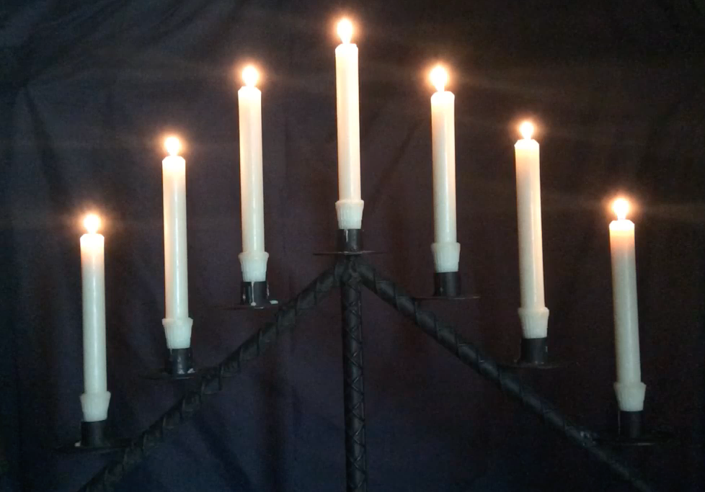

Slide 4
Antiphon 1
Cantor Zeal for your house has eaten me up;
the scorn of those who scorn you has fallen upon me.

Slide 5
Psalm 69:1-23 Salvum me fac
1 Save me, O God, *
for the waters have risen up to my neck.
2 I am sinking in deep mire, *
and there is no firm ground for my feet.
3 I have come into deep waters, *
and the torrent washes over me.
4 I have grown weary with my crying; my throat is inflamed; * my eyes have failed from looking for my God.
5 Those who hate me without a cause are more than the hairs of my head; my lying foes who would destroy me are mighty. *
Must I then give back what I never stole?
6 O God, you know my foolishness, * and my faults are not hidden from you.

Slide 6
7 Let not those who hope in you be put to shame through me, Lord God of hosts; * let not those who seek you be disgraced because of me,
O God of Israel.
8 Surely, for your sake have I suffered reproach, *
and shame has covered my face.
9 I have become a stranger to my own kindred, *
an alien to my mother’s children.
10 Zeal for your house has eaten me up; * the scorn of those who scorn you has fallen upon me.
11 I humbled myself with fasting, * but that was turned to my reproach.
12 I put on sack-cloth also, * and became a byword among them.

Slide 7
13 Those who sit at the gate murmur against me, *
and the drunkards make songs about me.
14 But as for me, this is my prayer to you, *
at the time you have set, O Lord:
15 “In your great mercy, O God, * answer me with your unfailing help.
16 Save me from the mire; do not let me sink; *
let me be rescued from those who hate me
and out of the deep waters.
17 Let not the torrent of waters wash over me,
neither let the deep swallow me up; * do not let the Pit shut its mouth upon me.
18 Answer me, O Lord, for your love is kind; *
in your great compassion, turn to me.”

Slide 8
19 “Hide not your face from your servant; * be swift and answer me, for I am in distress.
20 Draw near to me and redeem me; *
because of my enemies deliver me.
21 You know my reproach, my shame, and my dishonor; *
my adversaries are all in your sight.”
22 Reproach has broken my heart, and it cannot be healed; *
I looked for sympathy, but there was none,
for comforters, but I could find no one.
23 They gave me gall to eat, * and when I was thirsty, they gave me vinegar to drink.

Slide 9
Antiphon 1
Cantor Zeal for your house has eaten me up;
the scorn of those who scorn you has fallen upon me.

Slide 10
Antiphon 2
Cantor Let them draw back and be disgraced
who take pleasure in my misfortune.

Slide 11
Psalm 70 Deus, in adjutorium
1 Be pleased, O God, to deliver me; * O Lord, make haste to help me.
2 Let those who seek my life be ashamed
and altogether dismayed; * let those who take pleasure in my misfortune draw back
and be disgraced.
3 Let those who say to me “Aha!” and gloat over me turn back, *
because they are ashamed.
4 Let all who seek you rejoice and be glad in you; *
let those who love your salvation say for ever,
“Great is the Lord!”
5 But as for me, I am poor and needy; * come to me speedily, O God.
6 You are my helper and my deliverer; * O Lord, do not tarry.

Slide 12
Antiphon 2
Cantor Let them draw back and be disgraced
who take pleasure in my misfortune.

Slide 13
Antiphon 3
Cantor Arise, O God, maintain my cause.

Slide 14
Psalm 74 Ut quid, Deus?
1 O God, why have you utterly cast us off? * why is your wrath so hot against the sheep of your pasture?
2 Remember your congregation that you purchased long ago, *
the tribe you redeemed to be your inheritance,
and Mount Zion where you dwell.
3 Turn your steps toward the endless ruins; * the enemy has laid waste everything in your sanctuary.
4 Your adversaries roared in your holy place; *
they set up their banners as tokens of victory.
5 They were like men coming up with axes to a grove of trees; *
they broke down all your carved work
with hatchets and hammers.

Slide 15
6 They set fire to your holy place; * they defiled the dwelling-place of your Name
and razed it to the ground.
7 They said to themselves, “Let us destroy them altogether.” *
They burned down all the meeting-places of God in the land.
8 There are no signs for us to see; there is no prophet left; * there is not one among us who knows how long.
9 How long, O God, will the adversary scoff? *
will the enemy blaspheme your Name for ever?
10 Why do you draw back your hand? * why is your right hand hidden in your bosom?
11 Yet God is my King from ancient times, *
victorious in the midst of the earth.

Slide 16
12 You divided the sea by your might * and shattered the heads of the dragons upon the waters;
13 You crushed the heads of Leviathan * and gave him to the people of the desert for food.
14 You split open spring and torrent; *
you dried up ever-flowing rivers.
15 Yours is the day, yours also the night; *
you established the moon and the sun.
16 You fixed all the boundaries of the earth; *
you made both summer and winter.
17 Remember, O Lord, how the enemy scoffed, *
how a foolish people despised your Name.

Slide 17
18 Do not hand over the life of your dove to wild beasts; *
never forget the lives of your poor.
19 Look upon your covenant; * the dark places of the earth are haunts of violence.
20 Let not the oppressed turn away ashamed; *
let the poor and needy praise your Name.
21 Arise, O God, maintain your cause; *
remember how fools revile you all day long.
22 Forget not the clamor of your adversaries, * the unending tumult of those who rise up against you.

Slide 18
Antiphon 3
Cantor Arise, O God, maintain my cause.

Slide 19
Those who are able may stand
V. Deliver me, my God, from the hand of the wicked:
R. From the clutches of the evildoer and the oppressor.
Those who are able remain standing for a period of silent prayer.
When prompted by the first reader, everyone else sits down.

Slide 20
Lesson 1
Lamentations of Jeremiah [1:1-14]
Aleph. How solitary lies the city, once so full of people! How like a widow has she become, she that was great among the nations! She that was queen among the cities has now become a vassal.
Beth. She weeps bitterly in the night, tears run down her cheeks; among all her lovers she has none to comfort her; all become her enemies.
Gimel. Judah has gone into the misery of exile and of hard servitude; she dwells now among the nations, but finds no resting place; all her pursuers overtook her in the midst of her anguish.
Daleth. The roads to Zion mourn, because none come to the solemn feasts; all her gates are desolate, her priests groan and sigh; her virgins are afflicted, and she is in bitterness.
He. Her adversaries have become her masters, her enemies prosper; because the Lord has punished her for the multitude of her rebellions; her children are gone, driven away as captives by the enemy.

Slide 22
Those who are able may stand
Responsory 1 In monte Oliveti
V. On the mount of Olives Jesus prayed to the Father:
R. Father, if it be possible, let this cup pass from me.
The spirit indeed is willing, but the flesh is weak.
V. Watch and pray, that you may not enter into temptation.
R. The spirit indeed is willing, but the flesh is weak.
Those who are able remain standing for a period of silent prayer.
When prompted by the next reader, everyone else sits down.

Slide 23
Lesson 2
Waw. And from Daughter Zion all her majesty has departed; her princes have become like stags that can find no pasture, and that run without strength before the hunter.
Zayin. Jerusalem remembers in the days of her affliction and bitterness all the precious things that were hers from the days of old; when her people fell into the hand of the foe, and there was none to help her; the adversary saw her, and mocked at her downfall.
Heth. Jerusalem has sinned greatly, therefore she has become a thing unclean; all who honored her despise her, for they have seen her nakedness; and now she sighs, and turns her face away.
Teth. Uncleanness clung to her skirts, she took no thought of her doom; therefore her fall is terrible, she has no comforter. “O Lord, behold my affliction, for the enemy has triumphed.”

Slide 25
Those who are able may stand
Responsory 2 Tristis est anima mea
V. My soul is very sorrowful, even to the point of death;
remain here, and watch with me.
R. Now you shall see the crowd who will surround me;
you will flee, and I will go to be offered up for you.
V. Behold, the hour is at hand, and the Son of Man
is betrayed into the hands of sinners.
R. You will flee, and I will go to be offered up for you
Those who are able remain standing for a period of silent prayer.
When prompted by the next reader, everyone else sits down.

Slide 26
Lesson 3
Yodh. The adversary has stretched out his hand to seize all her precious things; she has seen the Gentiles invade her sanctuary, those whom you had forbidden to enter your congregation.
Kaph. All her people groan as they search for bread; they sell their own children for food to revive their strength. “Behold, O Lord, and consider, for I am now beneath contempt!”
Lamedh. Is it nothing to you, all you who pass by? Behold and see if there is any sorrow like my sorrow, which was brought upon me, which the Lord inflicted, on the day of his burning anger.
Mem. From on high he sent fire, into my bones it descended; he spread a net for my feet, and turned me back; he has left me desolate and faint all the day long.
Nun. My transgressions were bound into a yoke; by his hand they were fastened together; their yoke is upon my neck; he has caused my strength to fail. The Lord has delivered me into their hands, against whom I am not able to stand up.

Slide 28
Those who are able may stand
Responsory 3 Ecce vidimus eum
V. Lo, we have seen him without beauty or majesty,
with no looks to attract our eyes.
R. He bore our sins and grieved for us,
he was wounded for our transgressions,
and by his scourging we are healed.
V. Surely he has borne our griefs and carried our sorrows:
R. And by his scourging we are healed.
Those who are able remain standing for a period of silent prayer.
When prompted by the next reader, everyone else sits down.

Slide 29
Lesson 4
“For I have seen unrighteousness and strife in the city.”
See the glory of the cross itself. On the brow of kings that cross is now placed, the cross which enemies once mocked. Its power is shown in the result. He has conquered the world, not by steel, but by wood. The wood of the cross seemed a fitting object of scorn to his enemies, and standing before that wood they wagged their heads, saying, “If you are the Son of God, come down from the cross.” He stretched out his hands to an unbelieving and rebellious people. If one is just who lives by faith, one who does not have faith is unrighteous. Therefore when he says “unrighteousness,” understand that it is unbelief. The Lord then saw unrighteousness and strife in the city, and stretched out his hands to an unbelieving and rebellious people. And yet, looking upon them, he said, “Father, forgive them, for they know not what they do.”

Slide 31
Those who are able may stand
Responsory 4 Ecce quomodo moritur
V. See how the righteous one perishes, and no one takes it to heart.
R. The righteous are taken away, and no one understands.
From the face of evil the righteous one is taken away,
and his memory shall be in peace.
V. Like a sheep before its shearers is mute, so he opened not his mouth.
R. By oppression and judgment he was taken away:
And his memory shall be in peace.
Those who are able remain standing for a period of silent prayer.
When prompted by the next reader, everyone else sits down.

Slide 32
Antiphon 4
Cantor God did not spare his own Son, but delivered him up for us all.

Slide 33
Psalm 63:1-8 Deus, Deus meus
1 O God, you are my God; eagerly I seek you; * my soul thirsts for you, my flesh faints for you, as in a barren and dry land where there is no water.
2 Therefore I have gazed upon you in your holy place, *
that I might behold your power and your glory.
3 For your loving-kindness is better than life itself; *
my lips shall give you praise.
4 So will I bless you as long as I live *
and lift up my hands in your Name.
5 My soul is content, as with marrow and fatness, *
and my mouth praises you with joyful lips,

Slide 34
6 When I remember you upon my bed, * and meditate on you in the night watches.
7 For you have been my helper, * and under the shadow of your wings I will rejoice.
8 My soul clings to you; * your right hand holds me fast.

Slide 35
Antiphon 4
Cantor God did not spare his own Son, but delivered him up for us all.

Slide 36
Antiphon 5
Cantor From the gates of hell, O Lord, deliver my soul.

Slide 37
Those who are able may stand for a period of silent prayer

Slide 38
Antiphon 6
Cantor O Death, I will be your death; O Grave, I will be your destruction.

Slide 39
Psalm 150 Laudate Dominum
1 Hallelujah! Praise God in his holy temple; *
praise him in the firmament of his power.
2 Praise him for his mighty acts; * praise him for his excellent greatness.
3 Praise him with the blast of the ram’s-horn; *
praise him with lyre and harp.
4 Praise him with timbrel and dance; *
praise him with strings and pipe.
5 Praise him with resounding cymbals; *
praise him with loud-clanging cymbals.
6 Let everything that has breath *
praise the Lord. Hallelujah!

Slide 40
Antiphon 6
Cantor O Death, I will be your death; O Grave, I will be your destruction.

Slide 41
Lesson 5
The Song of Hezekiah [Isaiah 38:10-20]
In my despair I said, “In the noonday of my life I must depart; my unspent years are summoned to the portals of death.” And I said, “No more shall I see the Lord in the land of the living, never more look on my kind among dwellers on earth. My house is pulled down and I am uncovered, as when a shepherd strikes his tent. My life is rolled up like a bolt of cloth, the threads cut off from the loom.
Between sunrise and sunset my life is brought to an end; I cower and hope for the dawn. Like a lion he has crushed all my bones; like a swallow or thrush I utter plaintive cries; I mourn like a dove. My weary eyes look up to you; Lord, be my refuge in my affliction.” But what can I say? for he has spoken; it is he who has done this. Slow and halting are my steps all my days, because of the bitterness of my spirit.

Slide 42
O Lord, I recounted all these things to you and you rescued me; when entreated, you restored my life. I know now that my bitterness was for my good, for you held me back from the pit of destruction, you cast all my sins behind you. The grave does not thank you nor death give you praise; nor do those at the brink of the grave hang on your promises. It is the living, O Lord, the living who give you thanks as I do this day; You, Lord, are my Savior; I will praise you with stringed instruments all the days of my life, in the house of the Lord. From the gates of hell, O Lord, deliver my soul.

Slide 44
Responsory 5 Eram quasi agnus
V. I was like a trusting lamb led to the slaughter.
R. I did not know it was against me
that they devised schemes, saying,
Let us destroy the tree with its fruit;
let us cut him off from the land of the living.
V. All my enemies whispered together against me,
and devised evil against me saying:
R. Let us destroy the tree with its fruit;
let us cut him off from the land of the living.

Slide 45
Lesson 6
Letter to the Hebrews 4:15––5:10; 9:11-15a
We do not have a high priest who is unable to sympathize with our weaknesses, but one who in every respect has been tempted as we are, yet without sinning. Let us then with confidence draw near to the throne of grace, that we may receive mercy and find grace to help in time of need. For every high priest chosen from among men is appointed to act on behalf of men in relation to God, to offer gifts and sacrifices for sins. He can deal gently with the ignorant and wayward, since he himself is beset with weakness. Because of this he is bound to offer sacrifice for his own sins as well as for those of the people.

Slide 47
Responsory 6 Caro mea requiescet
V. My flesh also shall rest in hope:
R. You will not let your holy One see corruption.

Slide 48
All stand. During the singing of the following Canticle, the candles and all other lights (except the one remaining at the top of the triangular candlestick), are extinguished.

Slide 49
Antiphon 7
Cantor Now the women sitting at the tomb made lamentation, weeping for the Lord.

Slide 50
Canticle 16: Benedictus Dominus Deus Israel
Blessed be the Lord, the God of Israel; *
he has come to his people and set them free.
He has raised up for us a mighty savior, *
born of the house of his servant David.
Through his holy prophets he promised of old,
that he would save us from our enemies, *
from the hands of all who hate us.
He promised to show mercy to our fathers *
and to remember his holy covenant.
This was the oath he swore to our father Abraham, *
to set us free from the hands of our enemies,
Free to worship him without fear, *
holy and righteous in his sight all the days of our life.

Slide 51
You, my child, shall be called the prophet of the Most High, *
for you will go before the Lord to prepare his way,
To give his people knowledge of salvation *
by the forgiveness of their sins.
In the tender compassion of our God *
the dawn from on high shall break upon us,
To shine on those who dwell in darkness
and the shadow of death, *
and to guide our feet into the way of peace.
Glory to the Father, and to the Son, and to the Holy Spirit: *
as it was in the beginning, is now,
and will be for ever. Amen.

Slide 52
Antiphon 7
Cantor Now the women sitting at the tomb made lamentation, weeping for the Lord.

Slide 53
After the Canticle, during the repetition of the Antiphon, the remaining candle is taken from the stand and hidden in some convenient place.
All are able may kneel for the singing of the following anthem

Slide 55
Christus factus est
Christ for us became obedient unto death,
even death on a cross;
therefore God has highly exalted him
and bestowed on him the Name which is above every name.
A brief silence is observed.

Slide 56
The following Psalm is then said in unison prayerfully.
Psalm 51 Miserere mei, Deus
1 Have mercy on me, O God,
according to your loving-kindness; *
in your great compassion blot out my offenses.
2 Wash me through and through from my wickedness *
and cleanse me from my sin.
3 For I know my transgressions, *
and my sin is ever before me.
4 Against you only have I sinned * and done what is evil in your sight.
5 And so you are justified when you speak *
and upright in your judgment.

Slide 57
6 Indeed, I have been wicked from my birth, *
a sinner from my mother’s womb.
7 For behold, you look for truth deep within me, *
and will make me understand wisdom secretly.
8 Purge me from my sin, and I shall be pure; *
wash me, and I shall be clean indeed.
9 Make me hear of joy and gladness, *
that the body you have broken may rejoice.
10 Hide your face from my sins *
and blot out all my iniquities.
11 Create in me a clean heart, O God, *
and renew a right spirit within me.

Slide 58
12 Cast me not away from your presence *
and take not your holy Spirit from me.
13 Give me the joy of your saving help again *
and sustain me with your bountiful Spirit.
14 I shall teach your ways to the wicked, *
and sinners shall return to you.
15 Deliver me from death, O God, * and my tongue shall sing of your righteousness,
O God of my salvation.
16 Open my lips, O Lord, * and my mouth shall proclaim your praise.

Slide 59
17 Had you desired it, I would have offered sacrifice, *
but you take no delight in burnt-offerings.
18 The sacrifice of God is a troubled spirit; * a broken and contrite heart, O God, you will not despise.
19 Be favorable and gracious to Zion, *
and rebuild the walls of Jerusalem.
20 Then you will be pleased with the appointed sacrifices,
with burnt-offerings and oblations; *
then shall they offer young bullocks upon your altar.

Slide 60
The Officiant says the Collect without chant
Almighty God, we pray you graciously to behold this your family, for whom our Lord Jesus Christ was willing to be betrayed, and given into the hands of sinners, and to suffer death upon the cross.

Slide 61
Nothing further is said.

Slide 63
The remaining candle is brought from its hiding place and replaced on the stand.
By its light the people depart in silence.

