Slide 1
Stations of the Cross
With Meditations by Cardinal Ratzinger

Slide 2
Opening Devotions Facing the Altar
In the name of the Father, and of the Son, and of the Holy Spirit. Amen.
Officiant: Let us Pray. Almighty God, whose most dear Son went not up to joy but first he suffered pain, and entered not into glory before he was crucified: mercifully grant that we, walking in the way of the cross, may find it none other than the way of life and peace; through Jesus Christ your Son our Lord. Amen.
Our Father, who art in heaven, hallowed be thy Name, thy kingdom come, thy will be done, on earth as it is in heaven. Give us this day our daily bread. And forgive us our trespasses, as we forgive those who trespass against us. And lead us not into temptation, but deliver us from evil. Amen.

Slide 3
(Repeat the following 3 times enroute to the First Station)
Holy God,
Holy and Mighty,
Holy Immortal One, Have Mercy Upon Us

Slide 4
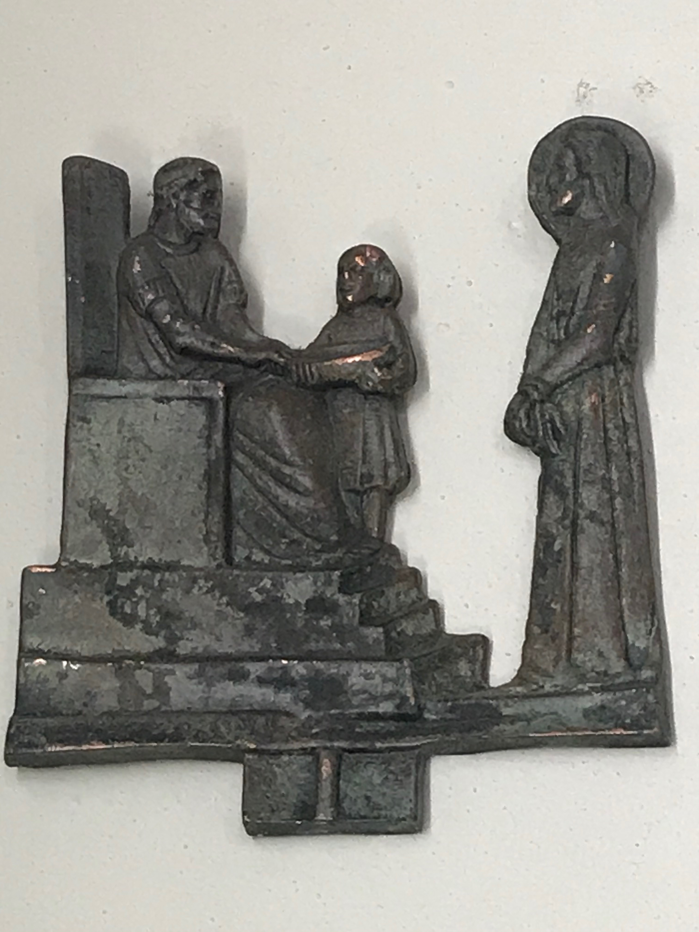
FIRST STATION
Jesus is condemned to death
V. We adore you O Christ and we bless you.
R. Because by your Holy Cross you have redeemed the world
Pilate said to them, “Then what should I do with Jesus who is called the Messiah?” All of them said, “Let him be crucified!” Then he asked, “Why, what evil has he done?” But they shouted all the more, “Let him be crucified!” So he released Barabbas for them; and after flogging Jesus, he handed him over to be crucified.

Slide 5
MEDITATION
The Judge of the world, who will come again to judge us all, stands there, dishonored and defenseless before the earthly judge. Pilate is not utterly evil. He knows that the condemned man is innocent, and he looks for a way to free him. But his heart is divided. And in the end he lets his own position, his own self-interest, prevail over what is right. Nor are the men who are shouting and demanding the death of Jesus utterly evil. Many of them, on the day of Pentecost, will feel “cut to the heart” (Acts 2:37), when Peter will say to them: “Jesus of Nazareth, a man attested to you by God … you crucified and killed by the hands of those outside the law” (Acts 2:22ff.). But at that moment they are caught up in the crowd. They are shouting because everyone else is shouting, and they are shouting the same thing that everyone else is shouting. And in this way, justice is trampled underfoot by weakness, cowardice and fear of the diktat of the ruling mind-set. The quiet voice of conscience is drowned out by the cries of the crowd. Evil draws its power from indecision and concern for what other people think.

Slide 6
Let us pray
Lord, you were condemned to death because fear of what other people may think suppressed the voice of conscience. So too, throughout history, the innocent have always been maltreated, condemned and killed. How many times have we ourselves preferred success to the truth, our reputation to justice? Strengthen the quiet voice of our conscience, your own voice, in our lives. Look at me as you looked at Peter after his denial. Let your gaze penetrate our hearts and indicate the direction our lives must take. On the day of Pentecost you stirred the hearts of those who, on Good Friday, clamored for your death, and you brought them to conversion. In this way you gave hope to all. Grant us, ever anew, the grace of conversion. Amen

Slide 7
Holy God,
Holy and Mighty,
Holy Immortal One, Have Mercy Upon Us

Slide 8
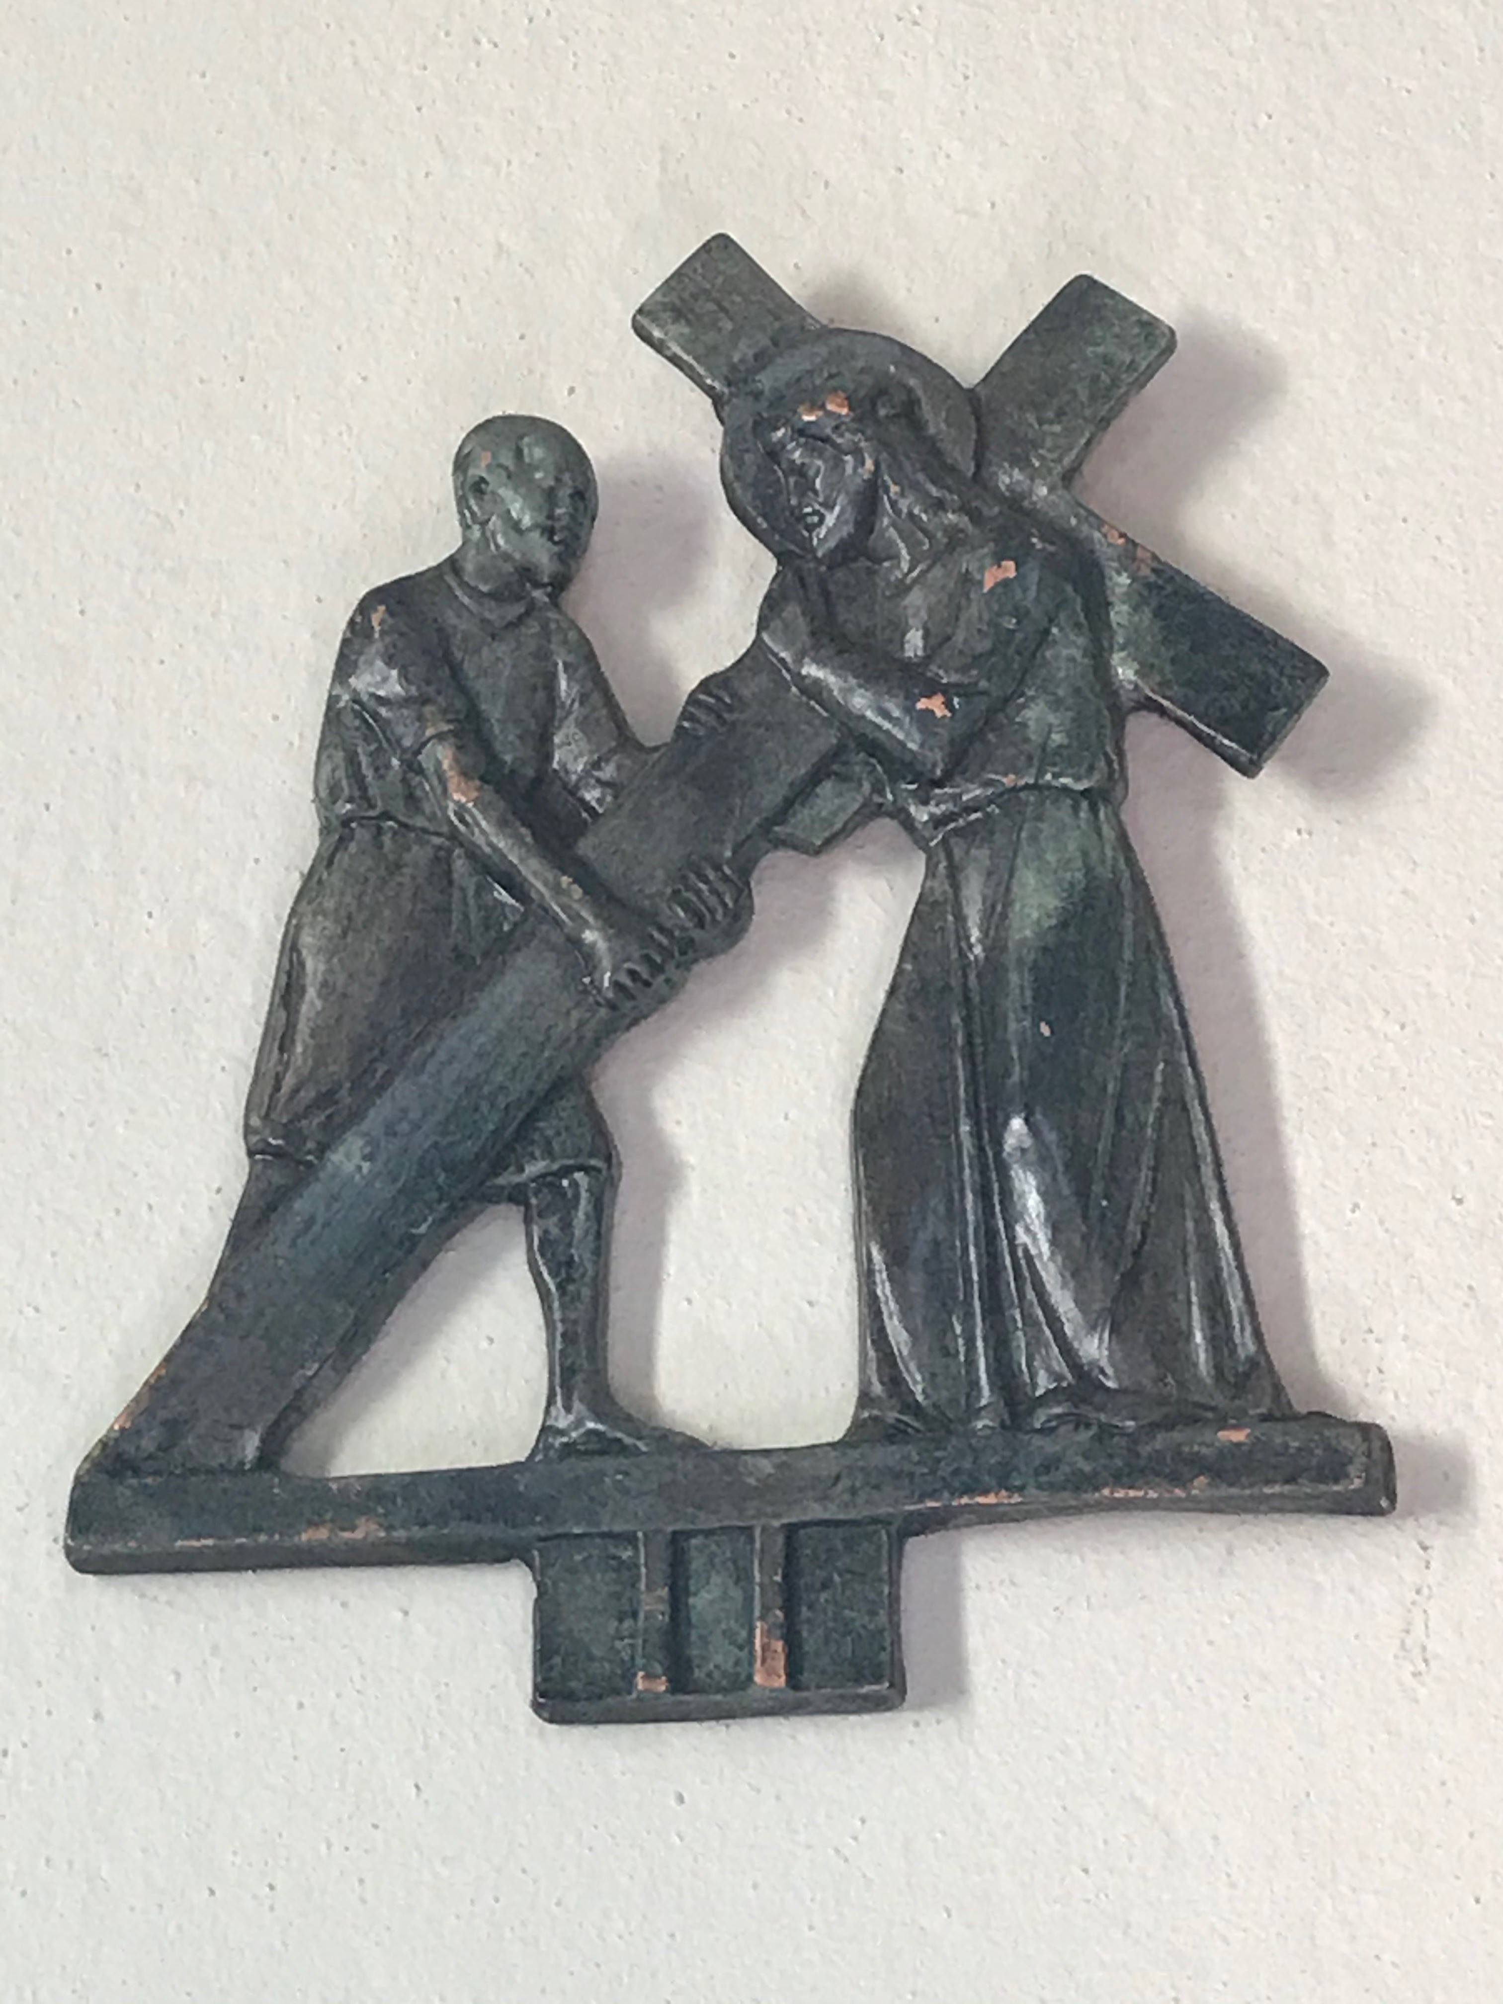
SECOND STATION Jesus takes up his Cross
V. We adore you O Christ and we bless you.
R. Because by your Holy Cross you have redeemed the world
Then the soldiers of the governor took Jesus into the governor’s headquarters, and they gathered the whole cohort around him. They stripped him and put a scarlet robe on him, and after twisting some thorns into a crown, they put it on his head. They put a reed in his right hand and knelt before him and mocked him, saying, “Hail, King of the Jews!” They spat on him, and took the reed and struck him on the head. After mocking him, they stripped him of the robe and put his own clothes on him. Then they led him away to crucify him.

Slide 9
MEDITATION
Jesus, condemned as an imposter king, is mocked, but this very mockery lays bare a painful truth. How often are the symbols of power, borne by the great ones of this world, an affront to truth, to justice and to the dignity of man! How many times are their pomps and their lofty words nothing but grandiose lies, a parody of their solemn obligation to serve the common good! It is because Jesus is mocked and wears the crown of suffering that he appears as the true King. His scepter is justice (cf. Psalm 45:7). The price of justice in this world is suffering: Jesus, the true King, does not reign through violence, but through a love which suffers for us and with us. He takes up the Cross, our cross, the burden of being human, the burden of the world. And so he goes before us and points out to us the way which leads to true life.

Slide 10
Let us pray,
Lord, you willingly subjected yourself to mockery and scorn. Help us not to ally ourselves with those who look down on the weak and suffering. Help us to acknowledge your face in the lowly and the outcast. May we never lose heart when faced with the contempt of this world, which ridicules our obedience to your will. You carried your own Cross and you ask us to follow you on this path (cf. Matthew 10:38). Help us to take up the Cross, and not to shun it. May we never complain or become discouraged by life’s trials. Help us to follow the path of love and, in submitting to its demands, to find true joy. Amen

Slide 11
Holy God,
Holy and Mighty,
Holy Immortal One, Have Mercy Upon Us

Slide 12
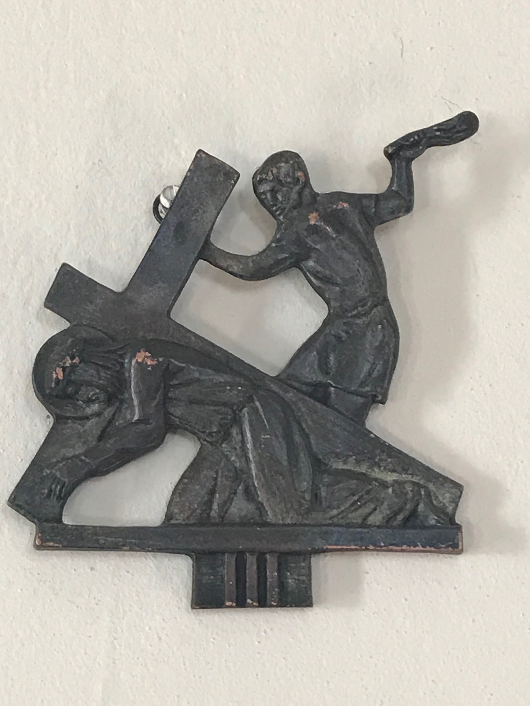
THIRD STATION Jesus falls for the first time
V. We adore you O Christ and we bless you.
R. Because by your Holy Cross you have redeemed the world
Surely he has born our griefs and carried our sorrows; yet we esteemed him stricken, smitten by God, and afflicted. But he was wounded for our transgressions, he was bruised for our iniquities; upon him was the chastisement that made us whole, and with his stripes we are healed. We all like sheep have gone astray; we have turned everyone to his own way; and the Lord has laid on him the iniquity of us all.

Slide 13
MEDITATION
Man has fallen, and he continues to fall: often he becomes a caricature of himself, no longer the image of God, but a mockery of the Creator. Is not the man who, on the way from Jerusalem to Jericho, fell among robbers who stripped him and left him half-dead and bleeding beside the road, the image of humanity par excellence? Jesus’ fall beneath the Cross is not just the fall of the man Jesus, exhausted from his scourging. There is a more profound meaning in this fall, as Paul tells us in the Letter to the Philippians: “though he was in the form of God, he did not count equality with God a thing to be grasped, but emptied himself, taking the form of a servant, being born in the likeness of men… He humbled himself and became obedient unto death, even death on a Cross” (Philippians 2:6-8). In Jesus’ fall beneath the weight of the Cross, the meaning of his whole life is seen: his voluntary abasement, which lifts us up from the depths of our pride. The nature of our pride is also revealed: it is that arrogance which makes us want to be liberated from God and left alone to ourselves, the arrogance which makes us think that we do not need his eternal love, but can be the masters of our own lives. In this rebellion against truth, in this attempt to be our own god, creator and judge, we fall headlong and plunge into self-destruction. The humility of Jesus is the surmounting of our pride; by his abasement he lifts us up. Let us allow him to lift us up. Let us strip away our sense of self-sufficiency, our false illusions of independence, and learn from him, the One who humbled himself, to discover our true greatness by bending low before God and before our downtrodden brothers and sisters.

Slide 14
Let us pray
Lord Jesus, the weight of the cross made you fall to the ground. The weight of our sin, the weight of our pride, brought you down. But your fall is not a tragedy, or mere human weakness. You came to us when, in our pride, we were laid low. The arrogance that makes us think that we ourselves can create human beings has turned man into a kind of merchandise, to be bought and sold, or stored to provide parts for experimentation. In doing this, we hope to conquer death by our own efforts, yet in reality we are profoundly debasing human dignity. Lord help us; we have fallen. Help us to abandon our destructive pride and, by learning from your humility, to rise again. Amen

Slide 15
Holy God,
Holy and Mighty,
Holy Immortal One, Have Mercy Upon Us

Slide 16
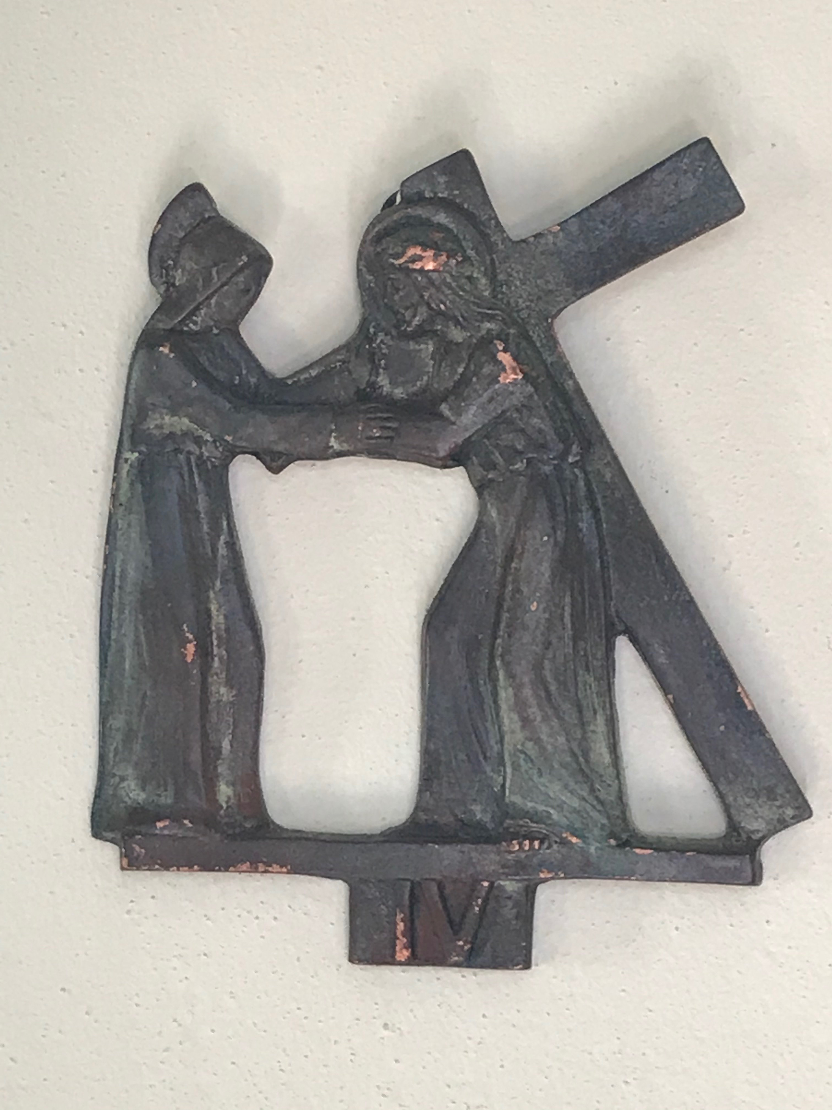
FOURTH STATION Jesus meets his Mother
V. We adore you O Christ and we bless you.
R. Because by your Holy Cross you have redeemed the world
Simon blessed them and said to Mary his mother: “Behold, this child is set for the fall and rising of many in Israel, and for a sign that is spoken against (and a sword will pierce through your own soul also), that thoughts out of many hearts may be revealed.” And his mother kept all these things in her heart.

Slide 17
MEDITATION
On Jesus’ Way of the Cross, we also find Mary, his Mother. During his public life she had to step aside, to make place for the birth of Jesus’ new family, the family of his disciples. She also had to hear the words: “Who is my mother and who are my brothers? … Whoever does the will of my Father in heaven is brother, and sister and mother” (Matthew 12:48-50). Now we see her as the Mother of Jesus, not only physically, but also in her heart. Even before she conceived him bodily, through her obedience she conceived him in her heart. It was said to Mary: “And behold, you will conceive in your womb and bear a son. He will be great and the Lord God will give to him the throne of his father David” (Luke 1:31ff.). And she would hear from the mouth of the elderly Simeon: “A sword will pierce through your own soul” (Luke 2:35). She would then recall the words of the prophets, words like these: “He was oppressed, and he was afflicted, yet he opened not his mouth; he was like a lamb that is led to slaughter” (Isaiah 54:7). Now it all takes place. In her heart she had kept the words of the angel, spoken to her in the beginning: “Do not be afraid, Mary” (Luke 1:30). The disciples fled, yet she did not flee. She stayed there, with a Mother’s courage, a Mother’s fidelity, a Mother’s goodness, and a faith which did not waver in the hour of darkness: “Blessed is she who believed” (Luke 1:45). “Nevertheless, when the Son of man comes, will he find faith on earth?” (Luke 18:8). Yes, in this moment Jesus knows: he will find faith. In this hour, this is his great consolation.

Slide 18
Let us pray,
Holy Mary, Mother of the Lord, you remained faithful when the disciples fled. Just as you believed the angels’ incredible message — that you would become the Mother of the Most High, so too you believed at the hour of his greatest abasement. In this way, at the hour of the Cross, at the hour of the world’s darkest night, you became the Mother of all believers, the Mother of the Church. We beg you: teach us to believe, and grant that our faith may bear fruit in courageous service and be the sign of a love ever ready to share suffering and to offer assistance. Amen

Slide 19
Holy God,
Holy and Mighty,
Holy Immortal One, Have Mercy Upon Us

Slide 20
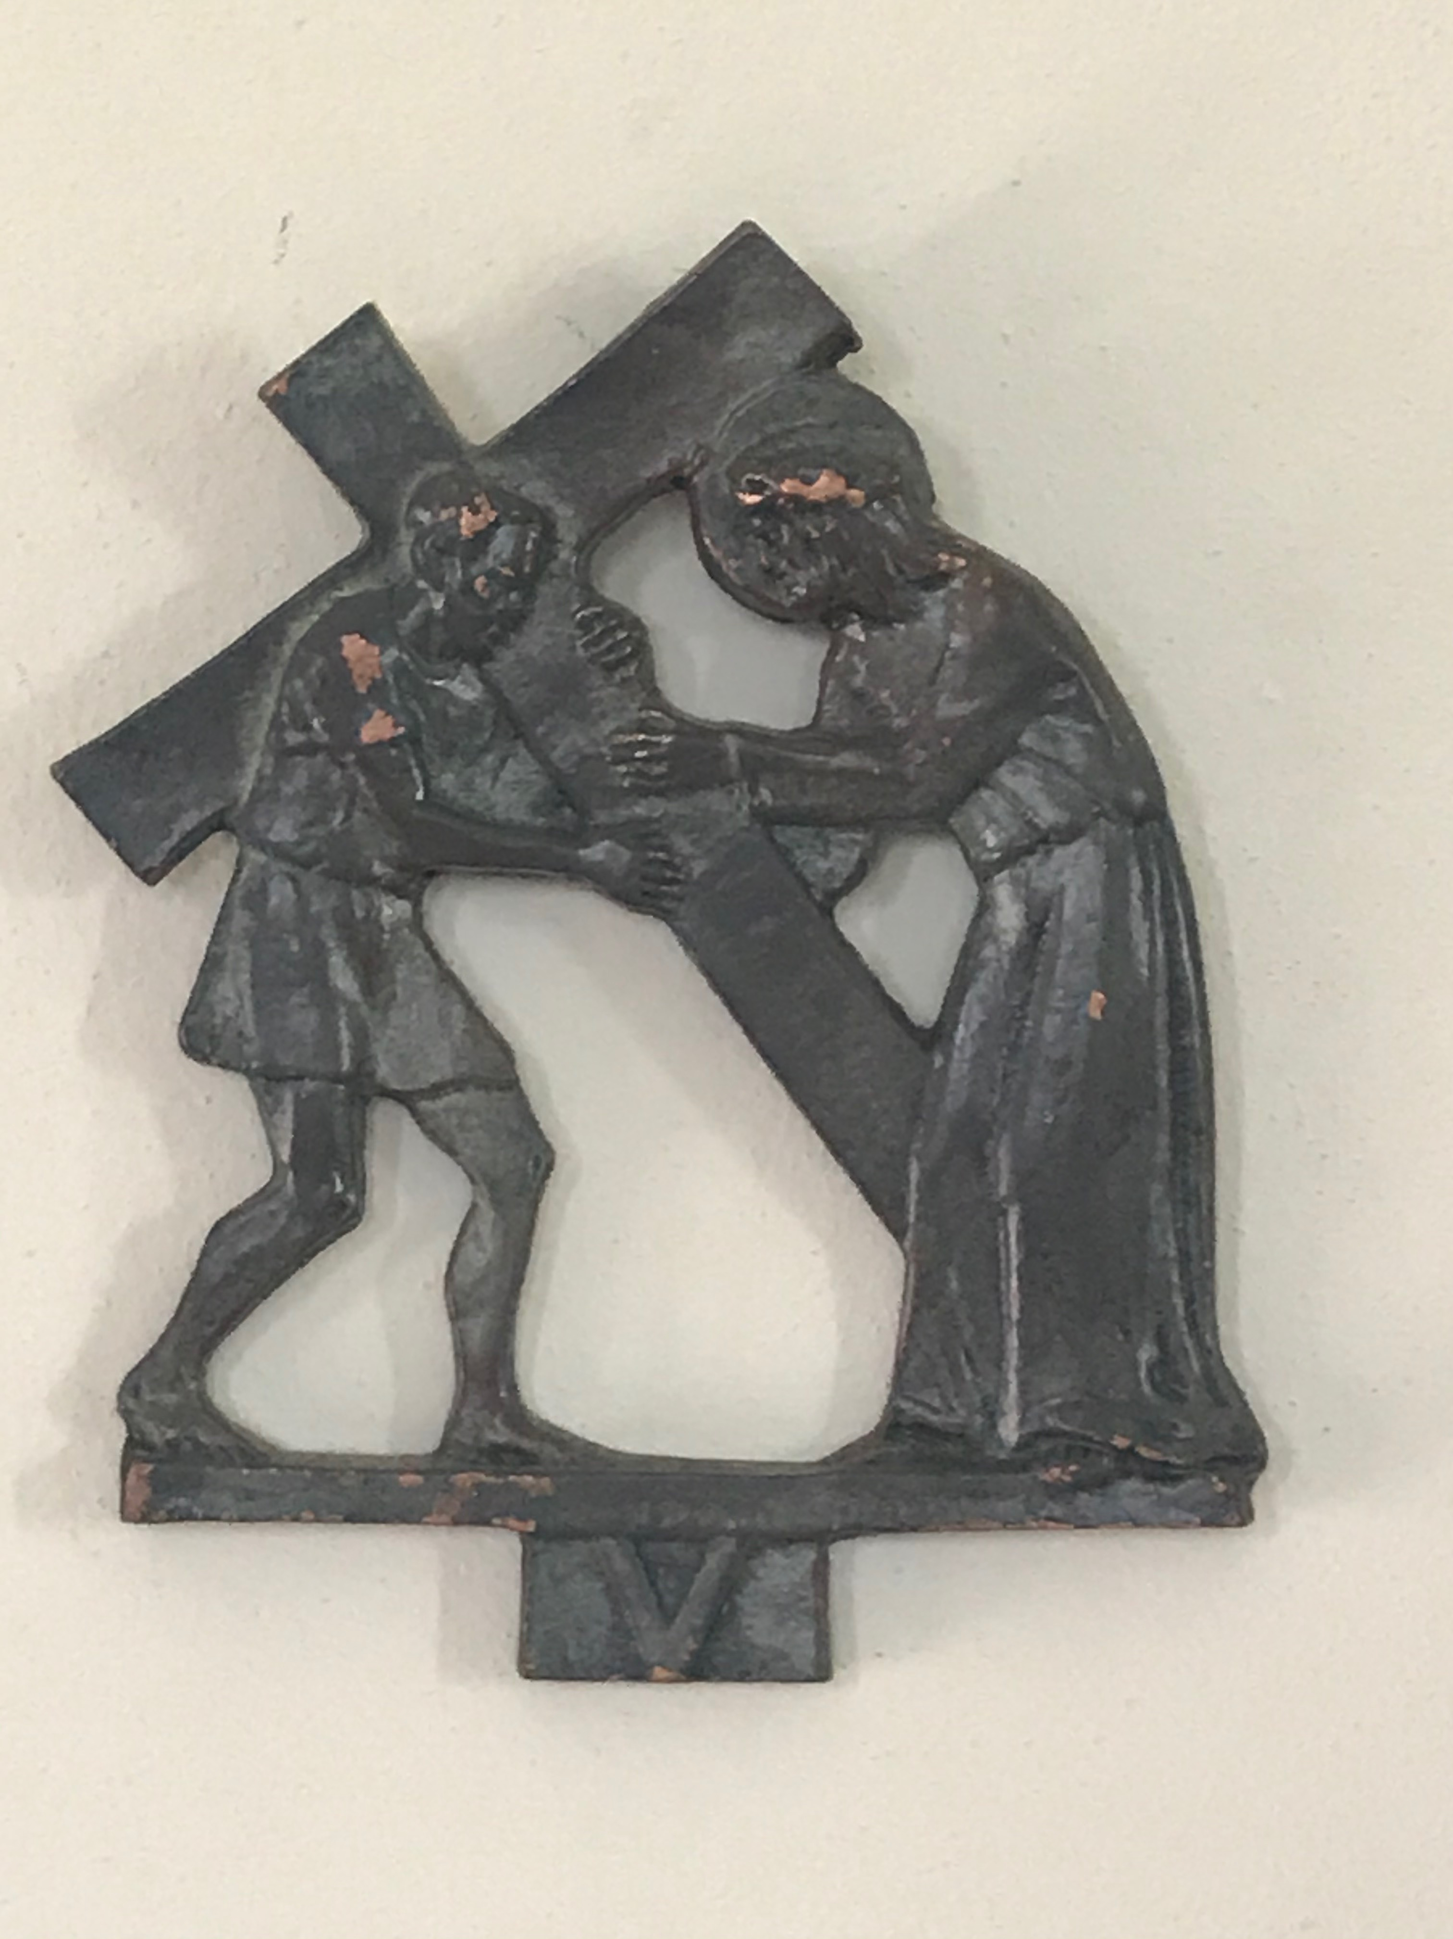
FIFTH STATION Simon of Cyrene helps Jesus carry the Cross
V. We adore you O Christ and we bless you.
R. Because by your Holy Cross you have redeemed the world
As they went out, they came upon a man of Cyrene, Simon by name; this man they compelled to carry his cross. Jesus told his disciples: “If any man would come after me, let him deny himself and take up his cross and follow me.”

Slide 21
MEDITATION
Simon of Cyrene is on his way home, returning from work, when he comes upon the sad procession of those condemned — for him, perhaps, it was a common sight. The soldiers force this rugged man from the country to carry the Cross on his own shoulders. How annoying he must have thought it to be suddenly caught up in the fate of those condemned men! He does what he must do, but reluctantly. Significantly, the Evangelist Mark does not only name him, but also his children, who were evidently known as Christians and as members of that community (cf. Mark 15:21). From this chance encounter, faith was born. The Cyrenian, walking beside Jesus and sharing the burden of the Cross, came to see that it was a grace to be able to accompany him to his crucifixion and to help him. The mystery of Jesus, silent and suffering, touched his heart. Jesus, whose divine love alone can redeem all humanity, wants us to share his Cross so that we can complete what is still lacking in his suffering (cf. Colossian 1:24). Whenever we show kindness to the suffering, the persecuted and defenseless, and share in their sufferings, we help to carry that same Cross of Jesus. In this way we obtain salvation, and help contribute to the salvation of the world.

Slide 22
Let us pray,
Lord, you opened the eyes and heart of Simon of Cyrene, and you gave him, by his share in your Cross, the grace of faith. Help us to aid our neighbors in need, even when this interferes with our own plans and desires. Help us to realize that it is a grace to be able to share the cross of others and, in this way, know that we are walking with you along the way. Help us to appreciate with joy that, when we share in your suffering and the sufferings of this world, we become servants of salvation and are able to help build up your Body, the Church. Amen

Slide 23
Holy God,
Holy and Mighty,
Holy Immortal One, Have Mercy Upon Us

Slide 24
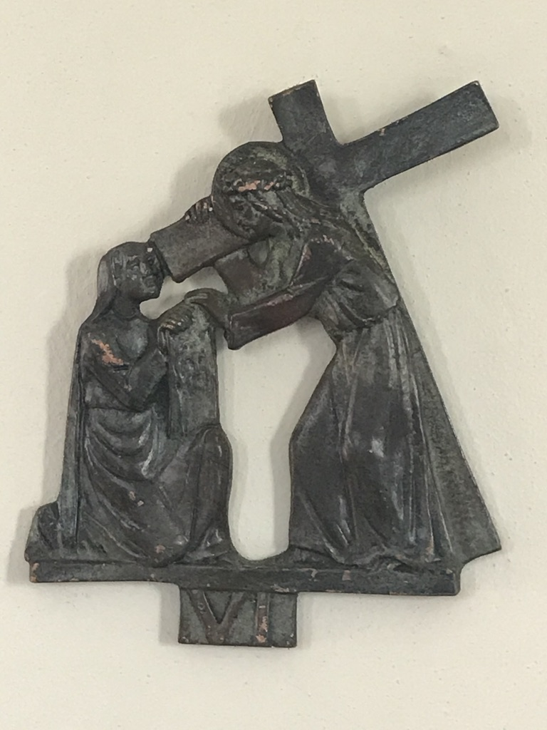
SIXTH STATION Veronica wipes the face of Jesus
V. We adore you O Christ and we bless you.
R. Because by your Holy Cross you have redeemed the world
He had no form or comeliness that we should look at him, and no beauty that we should desire him. He was despised and rejected by men; a man of sorrows, and acquainted with grief; and as one from whom men hide their faces he was despised, and we esteemed him not.
You have said, “Seek my face.” My heart says to you, “Your face, Lord, do I seek.” Hide not your face from me. Turn not your servant away in anger, you who have been my help. Cast me not off, forsake me not, O God of my salvation.

Slide 25
MEDITATION
“Your face, Lord, do I seek. Hide not your face from me” (Psalm 27:8-9). Veronica — Bernice, in the Greek tradition — embodies the universal yearning of the devout men and women of the Old Testament, the yearning of all believers to see the face of God. On Jesus’ Way of the Cross, though, she at first did nothing more than perform an act of womanly kindness: she held out a facecloth to Jesus. She did not let herself be deterred by the brutality of the soldiers or the fear which gripped the disciples. She is the image of that good woman, who, amid turmoil and dismay, shows the courage born of goodness and does not allow her heart to be bewildered. “Blessed are the pure in heart,” the Lord had said in his Sermon on the Mount, “for they shall see God” (Matthew 5:8). At first, Veronica saw only a buffeted and pain-filled face. Yet her act of love impressed the true image of Jesus on her heart: on his human face, bloodied and bruised, she saw the face of God and his goodness, which accompanies us even in our deepest sorrows. Only with the heart can we see Jesus. Only love purifies us and gives us the ability to see. Only love enables us to recognize the God who is love itself.

Slide 26
Let us pray,
Lord, grant us restless hearts, hearts which seek your face. Keep us from the blindness of heart which sees only the surface of things. Give us the simplicity and purity which allow us to recognize your presence in the world. When we are not able to accomplish great things, grant us the courage which is born of humility and goodness. Impress your face on our hearts. May we encounter you along the way and show your image to the world. Amen

Slide 27
Holy God,
Holy and Mighty,
Holy Immortal One, Have Mercy Upon Us

Slide 28
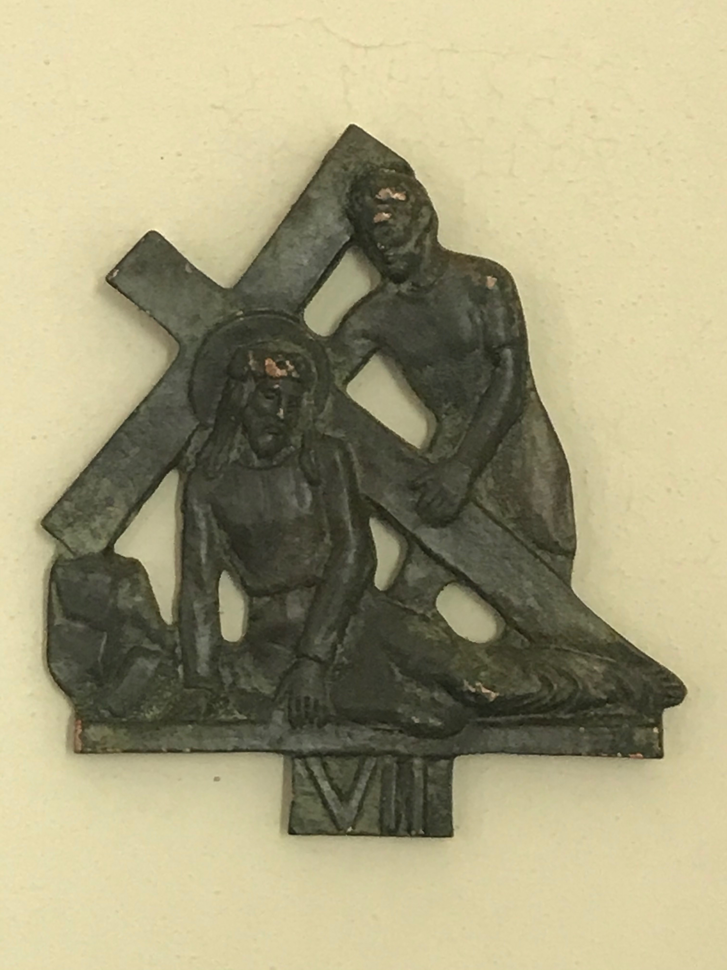
SEVENTH STATION Jesus falls for the second time
V. We adore you O Christ and we bless you.
R. Because by your Holy Cross you have redeemed the world
I am the man who has seen affliction under the rod of his wrath; he has driven and brought me into darkness without any light. He has blocked my way with hewn stones, he has made my paths crooked. He has made my teeth grind on gravel, and made me cower in ashes.

Slide 29
MEDITATION
The tradition that Jesus fell three times beneath the weight of the Cross evokes the fall of Adam — the state of fallen humanity — and the mystery of Jesus’ own sharing in our fall. Throughout history the fall of man constantly takes on new forms. In his First Letter, Saint John speaks of a threefold fall: lust of the flesh, lust of the eyes and the pride of life. He thus interprets the fall of man and humanity against the backdrop of the vices of his own time, with all its excesses and perversions. But we can also think, in more recent times, of how a Christianity which has grown weary of faith has abandoned the Lord: the great ideologies, and the banal existence of those who no longer believing in anything, who simply drift through life, have built a new and worse paganism, which in its attempt to do away with God once and for all, have ended up doing away with man. And so man lies fallen in the dust. The Lord bears this burden and falls, over and over again, in order to meet us. He gazes on us, he touches our hearts; he falls in order to raise us up.

Slide 30
Let us pray,
Lord Jesus Christ, you have borne all our burdens and you continue to carry us. Our weight has made you fall. Lift us up, for by ourselves we cannot rise from the dust. Free us from the bonds of lust. In place of a heart of stone, give us a heart of flesh, a heart capable of seeing. Lay low the power of ideologies, so that all may see that they are a web of lies. Do not let the wall of materialism become insurmountable. Make us aware of your presence. Keep us sober and vigilant, capable of resisting the forces of evil. Help us to recognize the spiritual and material needs of others, and to give them the help they need. Lift us up, so that we may lift others up. Give us hope at every moment of darkness, so that we may bring your hope to the world. Amen

Slide 31
Holy God,
Holy and Mighty,
Holy Immortal One, Have Mercy Upon Us

Slide 32
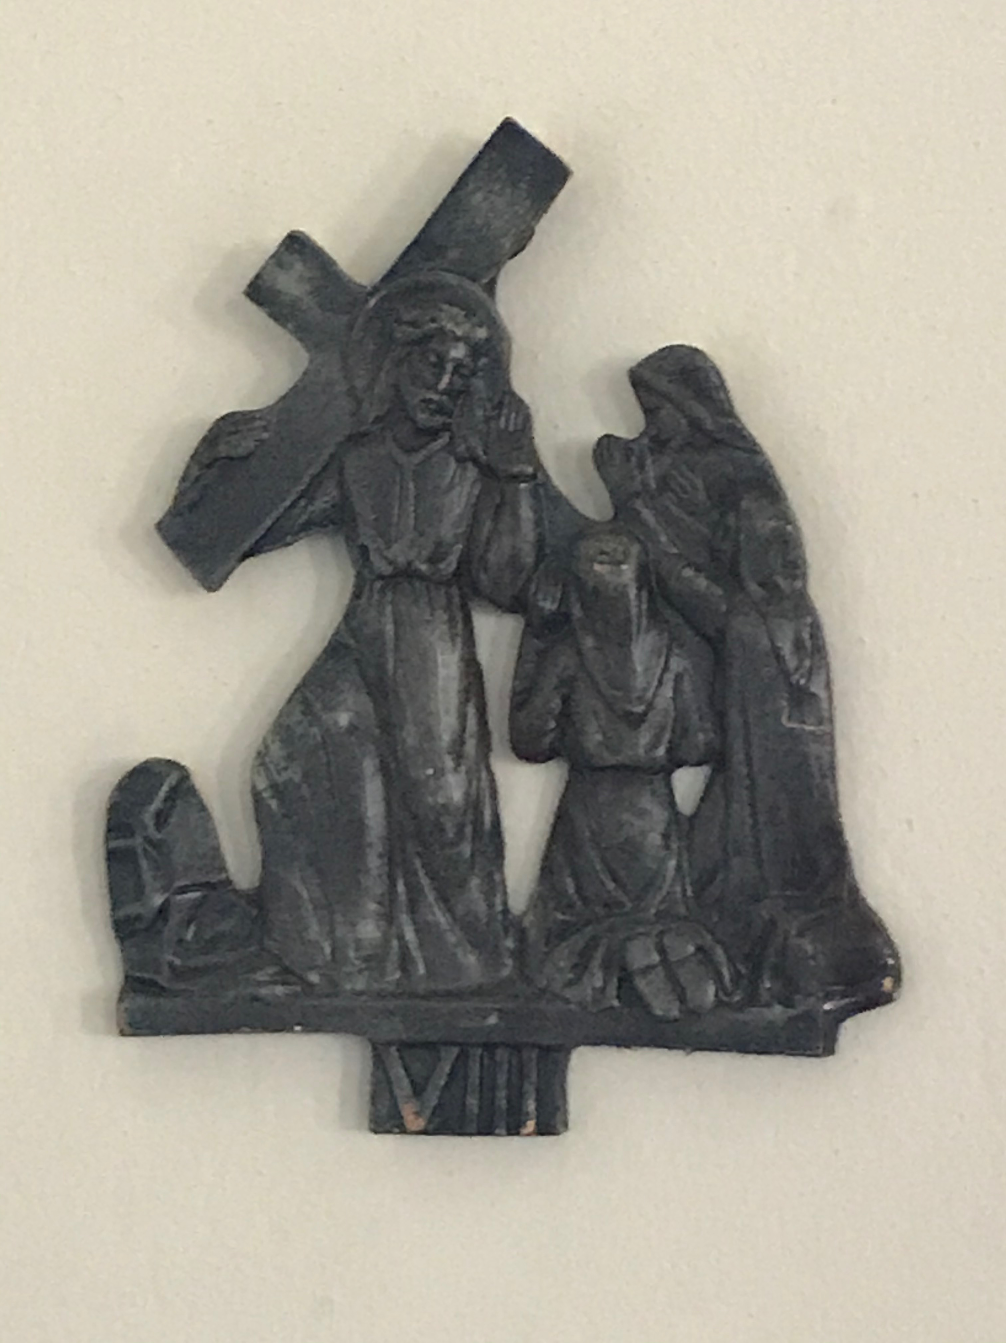
EIGHTH STATION Jesus meets the women of Jerusalem who weep for him
V. We adore you O Christ and we bless you.
R. Because by your Holy Cross you have redeemed the world
Jesus turning to them said, “Daughters of Jerusalem, do not weep for me, but weep for yourselves and for your children. For behold, the days are coming when they will say, ‘Blessed are the barren, and the wombs that never bore, and the breasts that never gave suck!’ Then they will begin to say to the mountains, ‘fall on us;’ and to the hills, ‘Cover us.’ For if they do this when the wood is green, what will happen when it is dry?”

Slide 33
MEDITATION
Hearing Jesus reproach the women of Jerusalem who follow him and weep for him ought to make us reflect. How should we understand his words? Are they not directed at a piety which is purely sentimental, one which fails to lead to conversion and living faith? It is no use to lament the sufferings of this world if our life goes on as usual. And so the Lord warns us of the danger in which we find ourselves. He shows us both the seriousness of sin and the seriousness of judgment. Can it be that, despite all our expressions of consternation in the face of evil and innocent suffering, we are all too prepared to trivialize the mystery of evil? Have we accepted only the gentleness and love of God and Jesus, and quietly set aside the word of judgment? “How can God be so concerned with our weaknesses?” we say. “We are only human!” Yet as we contemplate the sufferings of the Son, we see more clearly the seriousness of sin, and how it needs to be fully atoned if it is to be overcome. Before the image of the suffering Lord, evil can no longer be trivialized. To us too, he says: “Do not weep for me, weep for yourselves … if they do this when the wood is green, what will happen when it is dry?”

Slide 34
Let us pray,
Lord, to the weeping women you spoke of repentance and the Day of Judgment, when all of us will stand before your face: before you, the Judge of the world. You call us to leave behind the trivialization of evil, which salves our consciences and allows us to carry on as before. You show us the seriousness of our responsibility, the danger of our being found guilty and without excuse on the Day of Judgment. Grant that we may not simply walk at your side, with nothing to offer other than compassionate words. Convert us and give us new life. Grant that in the end we will not be dry wood, but living branches in you, the true vine, bearing fruit for eternal life.

Slide 35
Holy God,
Holy and Mighty,
Holy Immortal One, Have Mercy Upon Us

Slide 36
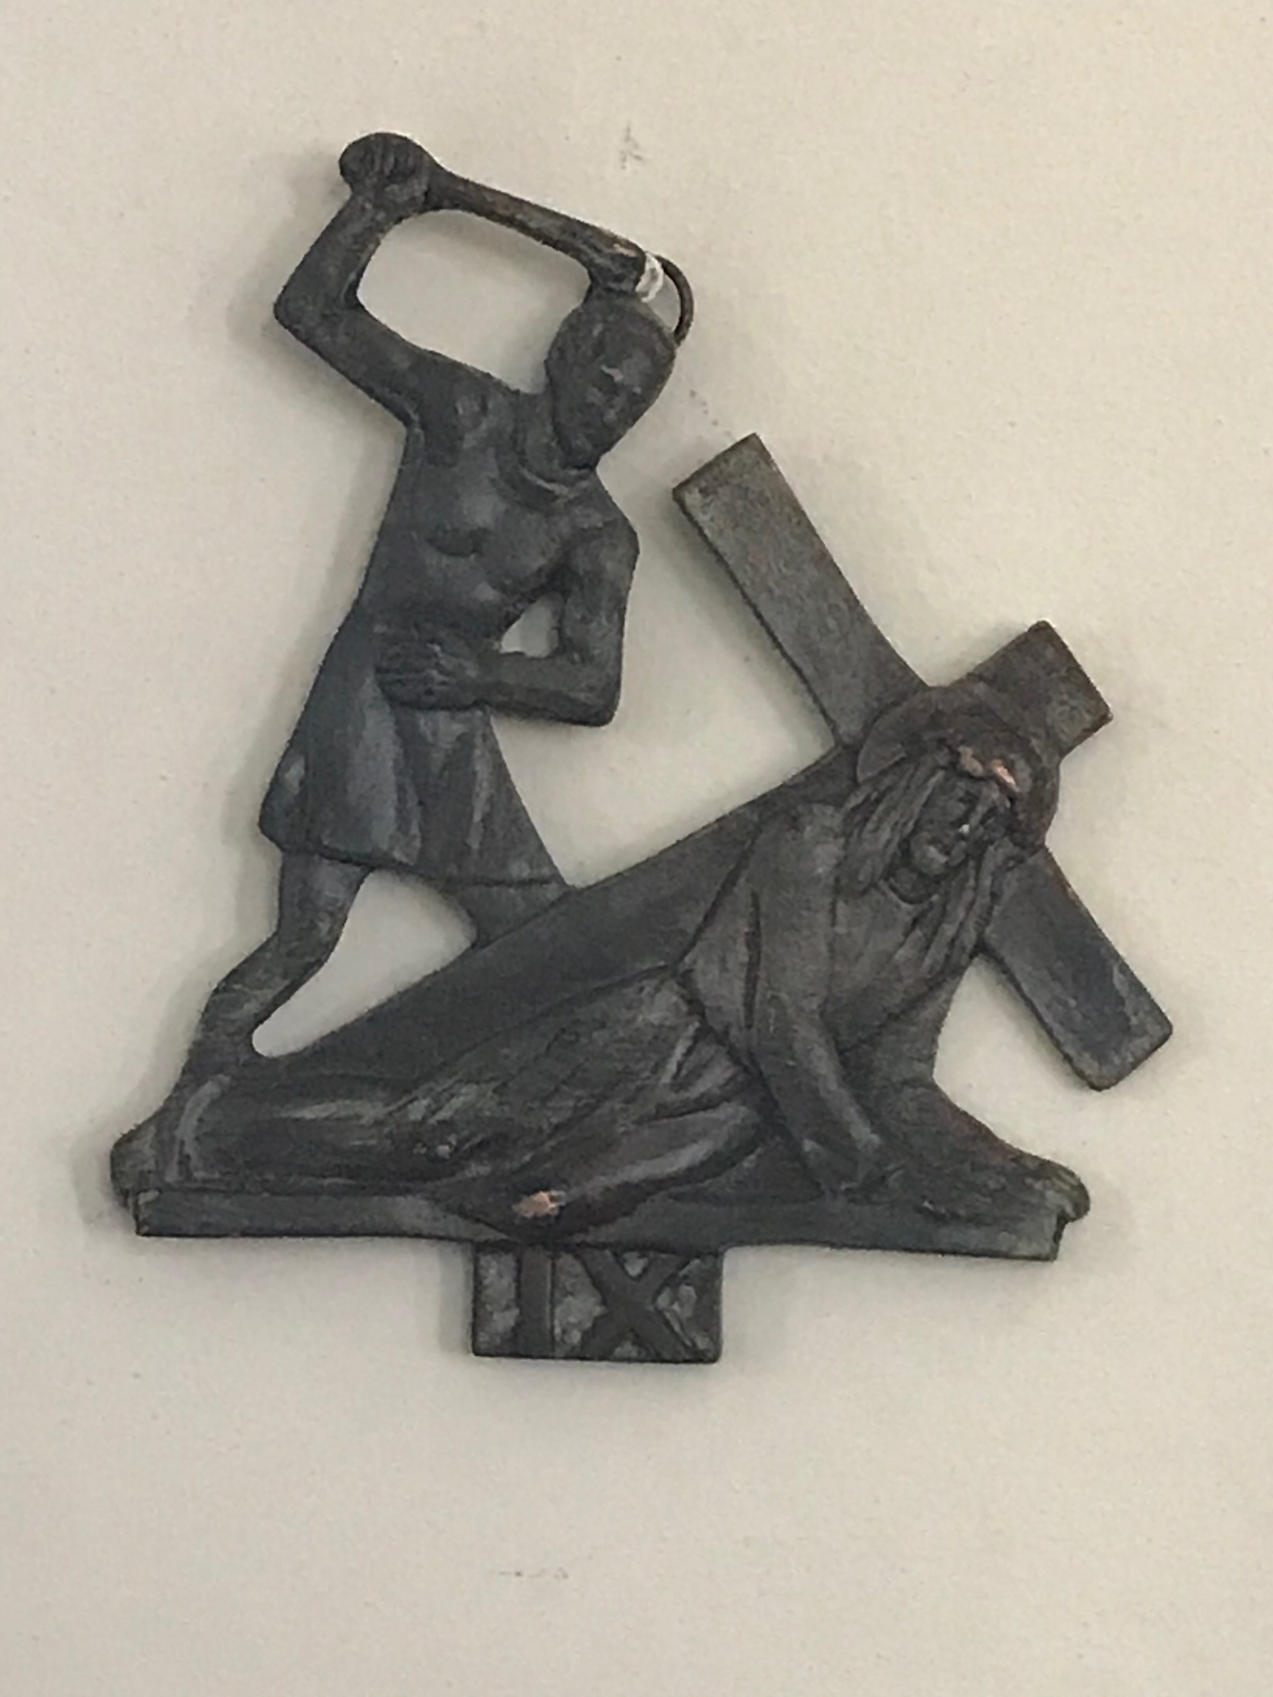
NINTH STATION Jesus falls for the third time
V. We adore you O Christ and we bless you.
R. Because by your Holy Cross you have redeemed the world
It is good for a man that he bear the yoke in his youth. Let him sit alone in silence when he has laid it on him; let him put his mouth in the dust — there may yet be hope; let him give his cheek to the smiter, and be filled with insults. For the Lord will not cast off for ever, but, though he cause grief, he will have compassion, according to the abundance of his steadfast love.

Slide 37
MEDITATION
What can the third fall of Jesus under the Cross say to us? We have considered the fall of man in general, and the falling of many Christians away from Christ and into a godless secularism. Should we not also think of how much Christ suffers in his own Church? How often is the holy sacrament of his Presence abused, how often must he enter empty and evil hearts! How often do we celebrate only ourselves, without even realizing that he is there! How often is his Word twisted and misused! What little faith is present behind so many theories, so many empty words! How much filth there is in the Church, and even among those who, in the priesthood, ought to belong entirely to him! How much pride, how much self-complacency! What little respect we pay to the Sacrament of Reconciliation, where he waits for us, ready to raise us up whenever we fall! All this is present in his Passion. His betrayal by his disciples, their unworthy reception of his Body and Blood, is certainly the greatest suffering endured by the Redeemer; it pierces his heart. We can only call to him from the depths of our hearts: Kyrie eleison — Lord, save us

Slide 38
Let us pray
Lord, your Church often seems like a boat about to sink, a boat taking in water on every side. In your field we see more weeds than wheat. The soiled garments and face of your Church throw us into confusion. Yet it is we ourselves who have soiled them! It is we who betray you time and time again, after all our lofty words and grand gestures. Have mercy on your Church; within her too, Adam continues to fall. When we fall, we drag you down to earth, and Satan laughs, for he hopes that you will not be able to rise from that fall; he hopes that being dragged down in the fall of your Church, you will remain prostrate and overpowered. But you will rise again. You stood up, you arose and you can also raise us up. Save and sanctify your Church. Save and sanctify us all. Amen

Slide 39
Holy God,
Holy and Mighty,
Holy Immortal One, Have Mercy Upon Us

Slide 40
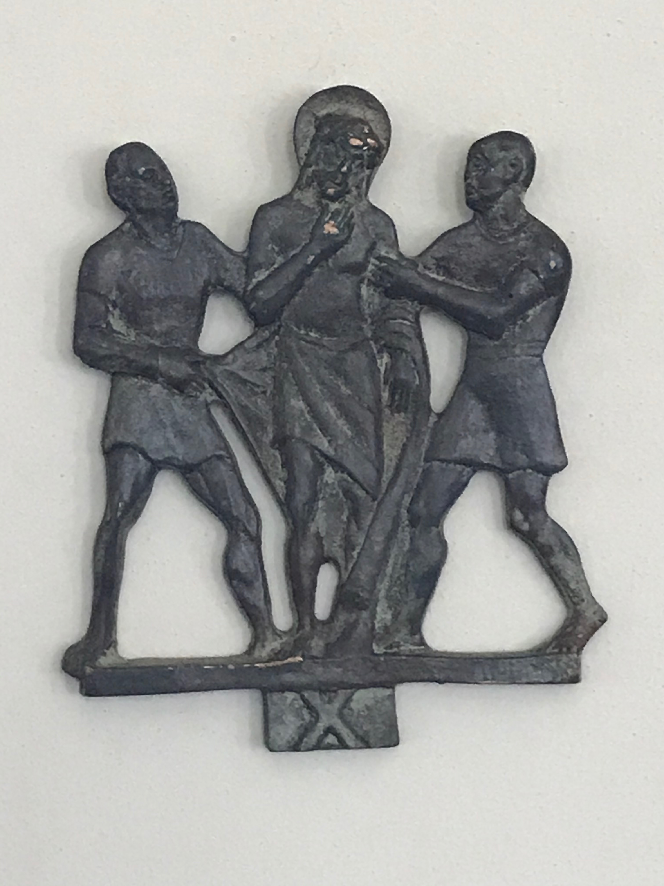
TENTH STATION Jesus is stripped of his garments
V. We adore you O Christ and we bless you.
R. Because by your Holy Cross you have redeemed the world
And when they came to a place called Golgotha (which means the place of a skull), they offered him wine to drink, mingled with gall, but when he tasted it, he would not drink it. And when they had crucified him, they divided his garments among them by casting lots; then they sat down and kept watch over him there.

Slide 41
MEDITATION
Jesus is stripped of his garments. Clothing gives a man his social position; it gives him his place in society, it makes him someone. His public stripping means that Jesus is no longer anything at all, he is simply an outcast, despised by all alike. The moment of the stripping reminds us of the expulsion from Paradise: God’s splendor has fallen away from man, who now stands naked and exposed, unclad and ashamed. And so Jesus once more takes on the condition of fallen man. Stripped of his garments, he reminds us that we have all lost the “first garment” that is God’s splendor. At the foot of the Cross, the soldiers draw lots to divide his paltry possessions, his clothes. The Evangelists describe the scene with words drawn from Psalm 22:19; by doing so they tell us the same thing that Jesus would tell his disciples on the road to Emmaus: that everything takes place “according to the Scriptures.” Nothing is mere coincidence; everything that happens is contained in the Word of God and sustained by his divine plan. The Lord passes through all the stages and steps of man’s fall from grace, yet each of these steps, for all its bitterness, becomes a step toward our redemption: this is how he carries home the lost sheep. Let us not forget that John says that lots were drawn for Jesus’ tunic, “woven without seam from top to bottom” (John 19:23). We may consider this as a reference to the High Priest’s robe, which was “woven from a single thread,” without stitching (Fl. Josephus, a III, 161). For he, the Crucified One, is the true High Priest.

Slide 42
Let us pray
Lord Jesus, you were stripped of your garments, exposed to shame, cast out of society. You took upon yourself the shame of Adam, and you healed it. You also take upon yourself the sufferings and the needs of the poor, the outcasts of our world. And in this very way you fulfill the words of the prophets. This is how you bring meaning into apparent meaninglessness. This is how you make us realize that your Father holds you, us, and the whole world in his hands. Give us a profound respect for man at every stage of his existence, and in all the situations in which we encounter him. Clothe us in the light of your grace. Amen

Slide 43
Holy God,
Holy and Mighty,
Holy Immortal One, Have Mercy Upon Us

Slide 44
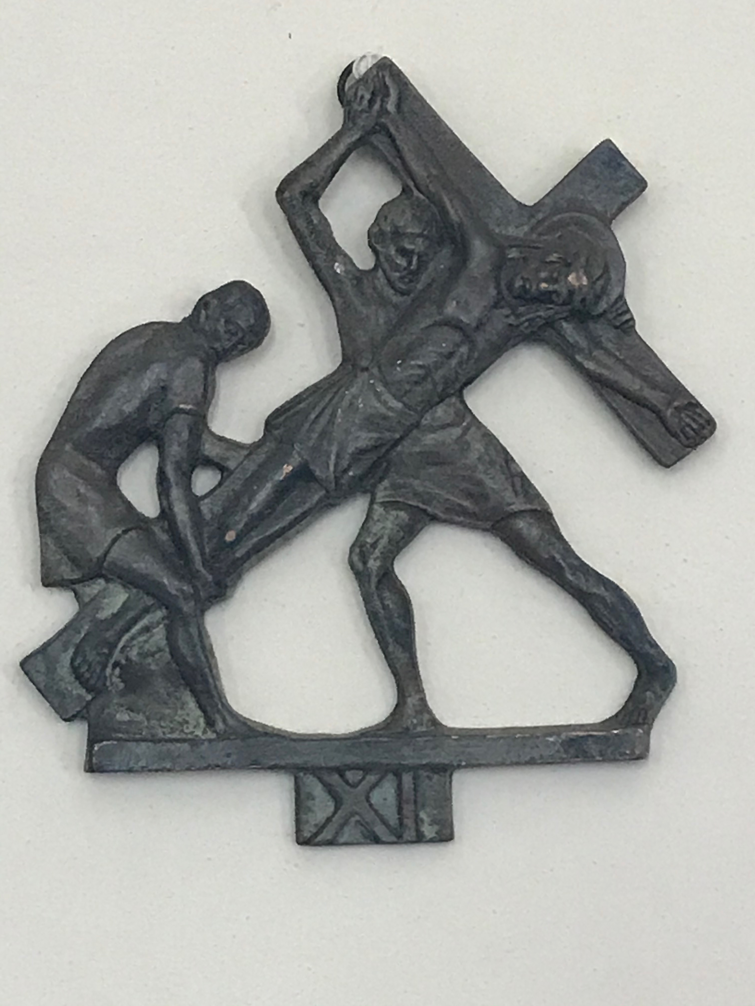
ELEVENTH STATION Jesus is nailed to the Cross
V. We adore you O Christ and we bless you.
R. Because by your Holy Cross you have redeemed the world
And over his head they put the charge against him, which read, “This is Jesus the King of the Jews.” Then two robbers were crucified with him, one on the right hand and one on the left. And those who passed by derided him, wagging their heads and saying, “You who would destroy the temple and build it in three days, save yourself! If you are the Son of God, come down from the Cross.” So also the chief priests with the scribes and elders mocked him, saying, “He saved others; he cannot save himself. He is the King of Israel; let him come down now from the Cross and we will believe in him.”

Slide 45
MEDITATION
Jesus is nailed to the Cross. The shroud of Turin gives us an idea of the unbelievable cruelty of this procedure. Jesus does not drink the numbing gall offered to him: he deliberately takes upon himself all the pain of the Crucifixion. His whole body is racked; the words of the Psalm have come to pass: “But I am a worm and no man, scorned by men, rejected by the people” (Psalm 22:7). “As one from whom men hide their faces, he was despised … surely he has borne our griefs and carried our sorrows” (Isaiah 53:3f.). Let us halt before this image of pain, before the suffering Son of God. Let us look upon him at times of presumptuousness and pleasure, in order to learn to respect limits and to see the superficiality of all merely material goods. Let us look upon him at times of trial and tribulation, and realize that it is then that we are closest to God. Let us try to see his face in the people we might look down upon. As we stand before the condemned Lord, who did not use his power to come down from the Cross, but endured its suffering to the end, another thought comes to mind. Ignatius of Antioch, a prisoner in chains for his faith in the Lord, praised the Christians of Smyrna for their invincible faith: he says that they were, so to speak, nailed with flesh and blood to the Cross of the Lord Jesus Christ (1:1). Let us nail ourselves to him, resisting the temptation to stand apart, or to join others in mocking him.

Slide 46
Let us pray
Lord Jesus Christ, you let yourself be nailed to the Cross, accepting the terrible cruelty of this suffering, the destruction of your body and your dignity. You allowed yourself to be nailed fast; you did not try to escape or to lessen your suffering. May we never flee from what we are called to do. Help us to remain faithful to you. Help us to unmask the false freedom which would distance us from you. Help us to accept your “binding” freedom, and, “bound” fast to you, to discover true freedom. Amen

Slide 47
Holy God,
Holy and Mighty,
Holy Immortal One, Have Mercy Upon Us

Slide 48
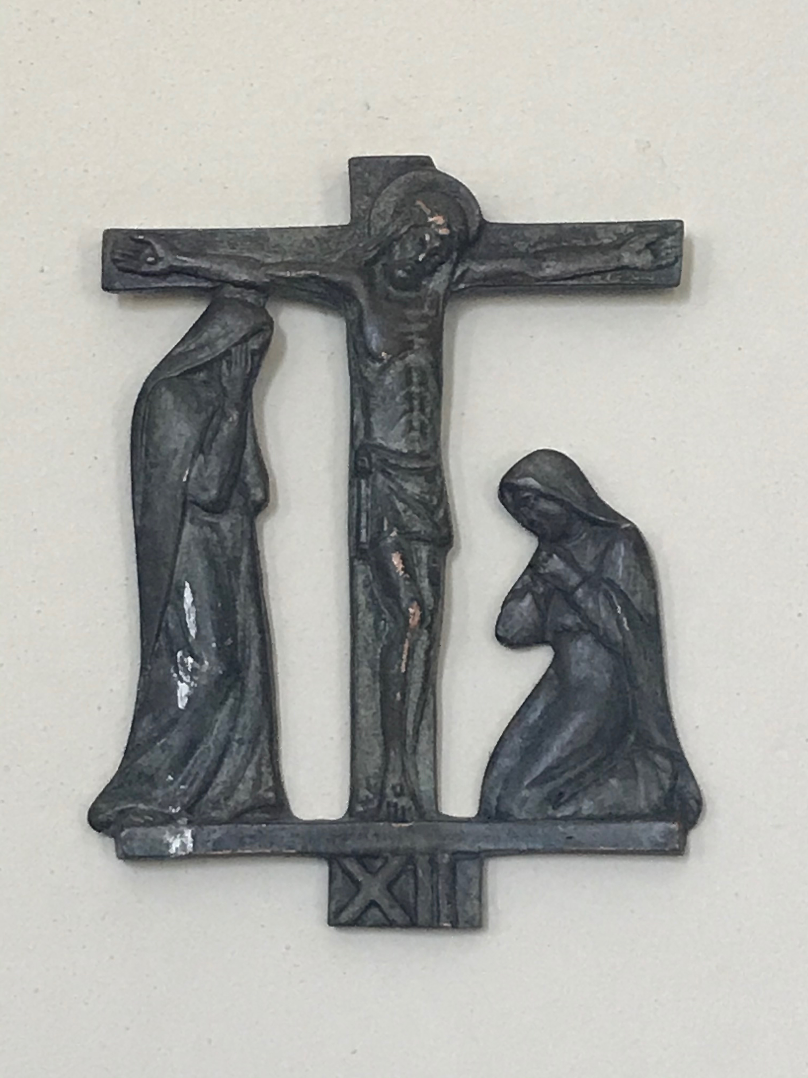
TWELFTH STATION Jesus dies on the Cross
V. We adore you O Christ and we bless you.
R. Because by your Holy Cross you have redeemed the world
Pilate also wrote a title and put it on the Cross; it read, “Jesus of Nazareth, the King of the Jews.” Many of the Jews read this title, for the place where Jesus was crucified was near the city; and it was written in Hebrew, in Latin, and in Greek. Now from the sixth hour there was darkness over all the land until the ninth hour. And about the ninth hour Jesus cried with a loud voice, “Eli, Eli, lama sabachthani?” That is, “My God, my God, why have you forsaken me?” And some of the bystanders hearing it said, “This man is calling Elijah.” And one of them at once ran and took a sponge, filled it with vinegar, and put it on a reed, and gave it to him to drink. But the others said, “Wait, let us see whether Elijah will come to save him.” And Jesus cried again with a loud voice and yielded up his spirit.” When the centurion and those who were with him, keeping watch over Jesus, saw the earthquake and what took place, they were filled with awe, and said, “Truly this was the Son of God!”

Slide 49
MEDITATION
In Greek and Latin, the two international languages of the time, and in Hebrew, the language of the Chosen People, a sign stood above the Cross of Jesus, indicating who he was: the King of the Jews, the promised Son of David. Pilate, the unjust judge, became a prophet despite himself. The kingship of Jesus was proclaimed before the entire world. Jesus himself had not accepted the title “Messiah,” because it would have suggested a mistaken, human idea of power and deliverance. Yet now the title can remain publicly displayed above the Crucified Christ. He is indeed the king of the world. Now he is truly “lifted up.” In sinking to the depths he rose to the heights. Now he has radically fulfilled the commandment of love, he has completed the offering of himself, and in this way he is now the revelation of the true God, the God who is love. Now we know who God is. Now we know what true kingship is. Jesus prays Psalm 22, which begins with the words: “My God, my God, why have you forsaken me?” (Psalm 22:2). He takes to himself the whole suffering people of Israel, all of suffering humanity, the drama of God’s darkness, and he makes God present in the very place where he seems definitively vanquished and absent. The Cross of Jesus is a cosmic event. The world is darkened, when the Son of God is given up to death. The earth trembles. And on the Cross, the Church of the Gentiles is born. The Roman centurion understands this, and acknowledges Jesus as the Son of God. From the Cross he triumphs — ever anew.

Slide 50
Let us pray
Lord Jesus Christ, at the hour of your death the sun was darkened. Ever anew you are being nailed to the Cross. At this present hour of history we are living in God’s darkness. Through your great sufferings and the wickedness of men, the face of God, your face, seems obscured, unrecognizable. And yet, on the Cross, you have revealed yourself. Precisely by being the one who suffers and loves, you are exalted. From the Cross on high you have triumphed. Help us to recognize your face at this hour of darkness and tribulation. Help us to believe in you and to follow you in our hour of darkness and need. Show yourself once more to the world at this hour. Reveal to us your salvation. Amen

Slide 51
Holy God,
Holy and Mighty,
Holy Immortal One, Have Mercy Upon Us

Slide 52
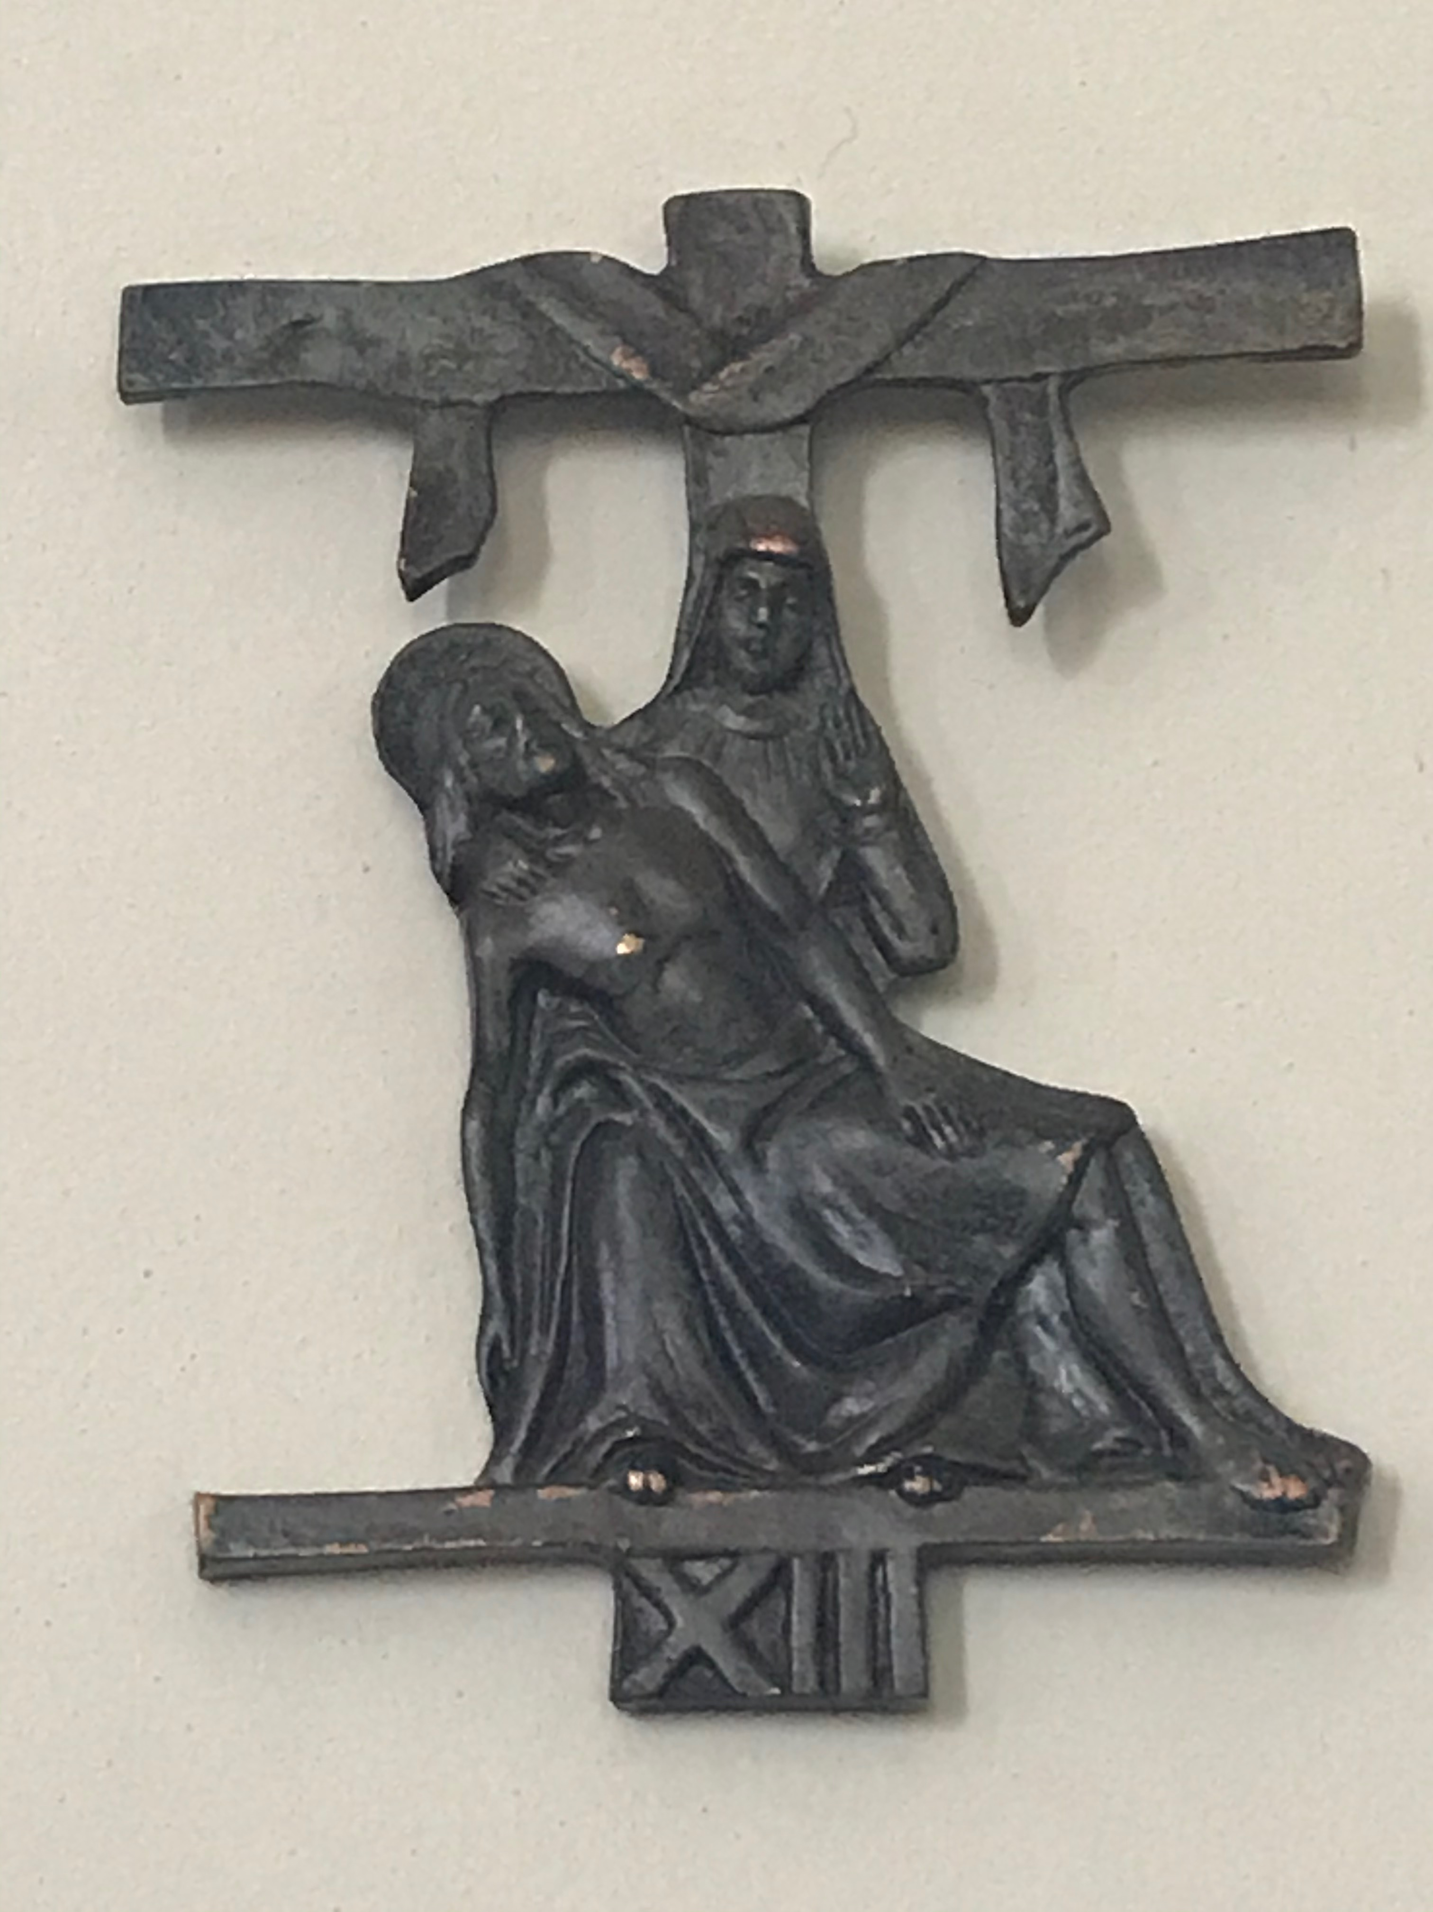
THIRTEENTH STATION Jesus is taken down from the Cross and given to his Mother
V. We adore you O Christ and we bless you.
R. Because by your Holy Cross you have redeemed the world
When the centurion and those who were with him, keeping watch over Jesus, saw the earthquake and what took place, they were filled with awe, and said, “Truly this was the Son of God!” There were also many women there, looking on from afar, who had followed Jesus from Galilee, ministering to him.

Slide 53
MEDITATION
Jesus is dead. From his heart, pierced by the lance of the Roman soldier, flow blood and water: a mysterious image of the stream of the sacraments, Baptism and the Eucharist, by which the Church is constantly reborn from the opened heart of the Lord. Jesus’ legs are not broken, like those of the two men crucified with him. He is thus revealed as the true Paschal lamb, not one of whose bones must be broken . And now, at the end of his sufferings, it is clear that, for all the dismay which filled men’s hearts, for all the power of hatred and cowardice, he was never alone. There are faithful ones who remain with him. Under the Cross stands Mary, his Mother, the sister of his Mother, Mary, Mary Magdalen and the disciple whom he loved. A wealthy man, Joseph of Arimathea, appears on the scene: a rich man is able to pass through the eye of a needle, for God has given him the grace. He buries Jesus in his own empty tomb, in a garden. At Jesus’ burial, the cemetery becomes a garden, the garden from which Adam was cast out when he abandoned the fullness of life, his Creator. The garden tomb symbolizes that the dominion of death is about to end. A member of the Sanhedrin also comes along, Nicodemus, to whom Jesus had proclaimed the mystery of rebirth by water and the Spirit. Even in the Sanhedrin, which decreed his death, there is a believer, someone who knows and recognizes Jesus after his death. In this hour of immense grief, of darkness and despair, the light of hope is mysteriously present. The hidden God continues to be the God of life, ever near. Even in the night of death, the Lord continues to be our Lord and Savior. The Church of Jesus Christ, his new family, begins to take shape.

Slide 54
Let us pray
Lord, you descended into the darkness of death. But your body is placed in good hands and wrapped in a white shroud (Matthew 27:59). Faith has not completely died; the sun has not completely set. How often does it appear that you are asleep? How easy it is for us to step back and say to ourselves: “God is dead.” In the hour of darkness, help us to know that you are still there. Do not abandon us when we are tempted to lose heart. Help us not to leave you alone. Give us the fidelity to withstand moments of confusion and a love ready to embrace you in your utter helplessness, like your Mother, who once more holds you to her breast. Help us, the poor and rich, simple and learned, to look beyond all our fears and prejudices, and to offer you our abilities, our hearts and our time, and thus to prepare a garden for the Resurrection. Amen

Slide 55
Holy God,
Holy and Mighty,
Holy Immortal One, Have Mercy Upon Us

Slide 56
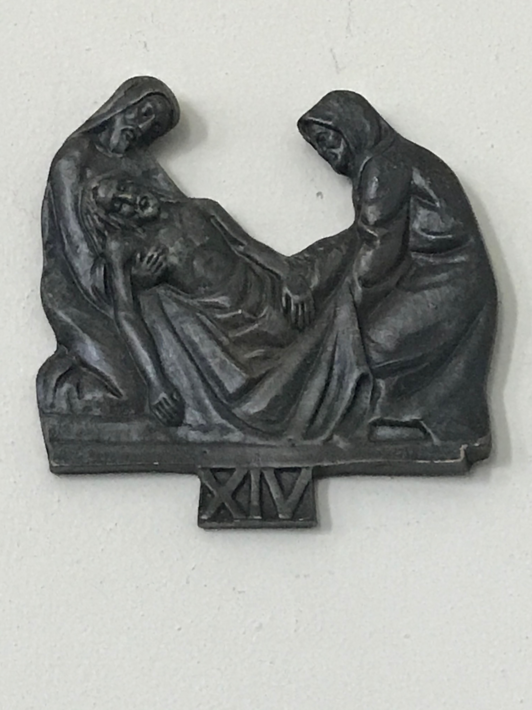
FOURTEENTH STATION Jesus is laid in the tomb
V. We adore you O Christ and we bless you.
R. Because by your Holy Cross you have redeemed the world
Joseph took the body, and wrapped it in a clean linen shroud, and laid it in his own new tomb, which he had hewn in the rock; and he rolled a great stone to the door of the tomb, and departed. Mary Magdalene and the other Mary were there, sitting opposite the sepulcher.

Slide 57
MEDITATION
Jesus, disgraced and mistreated, is honorably buried in a new tomb. Nicodemus brings a mixture of myrrh and aloes, about a hundred pounds weight, which gives off a precious scent. In the Son’s self-offering, as at his anointing in Bethany, we see an “excess” which evokes God’s generous and superabundant love. God offers himself unstintingly. If God’s measure is superabundance, then we for our part should consider nothing too much for God. This is the teaching of Jesus himself, in the Sermon on the Mount (Mt 5:20). But we should also remember the words of Saint Paul, who says that God “through us spreads the fragrance of the knowledge of Christ everywhere. We are the aroma of Christ” (2 Corinthians 2:14ff.). Amid the decay of ideologies, our faith needs once more to be the fragrance which returns us to the path of life. At the very moment of his burial, Jesus’ words are fulfilled: “Truly, truly, I say to you, unless a grain of wheat falls to the earth and dies, it remains alone; but if it dies, it bears much fruit” (John 12:24). Jesus is the grain of wheat which dies. From that lifeless grain of wheat comes forth the great multiplication of bread which will endure until the end of the world. Jesus is the bread of life which can satisfy superabundantly the hunger of all humanity and provide its deepest nourishment. Through his Cross and Resurrection, the eternal Word of God became flesh and bread for us. The mystery of the Eucharist already shines forth in the burial of Jesus.

Slide 58
Let us pray
Lord Jesus Christ, in your burial you have taken on the death of the grain of wheat. You have become the lifeless grain of wheat which produces abundant fruit for every age and for all eternity. From the tomb shines forth in every generation the promise of the grain of wheat which gives rise to the true manna, the Bread of Life, in which you offer us your very self. The eternal Word, through his Incarnation and death, has become a Word which is close to us: you put yourself into our hands and into our hearts, so that your word can grow within us and bear fruit. Through the death of the grain of wheat you give us yourself, so that we too can dare to lose our life in order to find it, so that we too can trust the promise of the grain of wheat. Help us grow in love and veneration for your Eucharistic mystery — to make you, the Bread of heaven, the source of our life. Help us to become your “fragrance,” and to make known in this world the mysterious traces of your life. Like the grain of wheat which rises from the earth, putting forth its stalk and then its ear, you could not remain enclosed in the tomb: the tomb is empty because he — the Father — “did not abandon you to the nether world, nor let your flesh see corruption” . No, you did not see corruption. You have risen, and have made a place for our transfigured flesh in the very heart of God. Help us to rejoice in this hope and bring it joyfully to the world. Help us to become witnesses of your Resurrection. Amen

Slide 59
Holy God,
Holy and Mighty,
Holy Immortal One, Have Mercy Upon Us

Slide 60
CLOSING PRAYER AT THE ALTAR (SAID BY ALL)
Let us pray
Lord Jesus Christ, you stretched out your arms of love on the hard wood of the cross that everyone might come within the reach of your saving embrace: So clothe us in your Spirit that we, reaching forth our hands in love, may bring those who do not know you to the knowledge and love of you; for the honor of your Name. Amen.
Officiant May the Lord bless us and keep us, for this day and evermore.
Amen

