Slide 1
A Liturgy for Maundy Thursday

Slide 2
Entrance Song to Athene Sir John Tavener

Slide 3
Penitential Order
Officiant Blessed be the God of our salvation: People Who bears our burdens and forgives our sins.
Officiant Since we have a great high priest who has passed through the heavens, Jesus, the Son of God, let us with confidence draw near to the throne of grace, that we may receive mercy and find grace to help in time of need. Hebrews 4:14,16

Slide 4
Confession
The Deacon then says
Let us confess our sins against God and our neighbor.
Silence may be kept.
All God of all mercy,
we confess that we have sinned against you,
opposing your will in our lives.
We have denied your goodness in each other,
in ourselves, and in the world you have created.
We repent of the evil that enslaves us,
the evil we have done,
and the evil done on our behalf.
Forgive, restore, and strengthen us
through our Savior Jesus Christ,
that we may abide in your love
and serve only your will. Amen.
The Priest says
Almighty God have mercy on you, forgive you all your sins through our Lord Jesus Christ, strengthen you in all goodness, and by the power of the Holy Spirit keep you in eternal life. Amen.

Slide 5
The Trisagion (Sung three times)
Cantor Holy God, Holy and Mighty,
Holy Immortal One,
All Have mercy upon us.
Interlude Trisagion. Sir John Tavener

Slide 6
Collect of the Day
Celebrant. Hear our cry, O God!
People And listen to our prayer.
Celebrant Let us pray. Almighty Father, whose dear Son, on the night before he suffered, instituted the Sacrament of his Body and Blood: Mercifully grant that we may receive it thankfully in remembrance of Jesus Christ our Lord, who in these holy mysteries gives us a pledge of eternal life; and who now lives and reigns with you and the Holy Spirit, one God, for ever and ever. Amen.

Slide 7
A Reading from the Book of Exodus 12:1-14
The LORD said to Moses and Aaron in the land of Egypt: “This month shall mark for you the beginning of months; it shall be the first month of the year for you. Tell the whole congregation of Israel that on the tenth of this month they are to take a lamb for each family, a lamb for each household. If a household is too small for a whole lamb, it shall join its closest neighbor in obtaining one; the lamb shall be divided in proportion to the number of people who eat of it. Your lamb shall be without blemish, a year-old male; you may take it from the sheep or from the goats. You shall keep it until the fourteenth day of this month; then the whole assembled congregation of Israel shall slaughter it at twilight. They shall take some of the blood and put it on the two doorposts and the lintel of the houses in which they eat it. They shall eat the lamb that same night; they shall eat it roasted over the fire with unleavened bread and bitter herbs. Do not eat any of it raw or boiled in water, but roasted over the fire, with its head, legs, and inner organs. You shall let none of it remain until the morning; anything that remains until the morning you shall burn. This is how you shall eat it: your loins girded, your sandals on your feet, and your staff in your hand; and you shall eat it hurriedly. It is the passover of the LORD. For I will pass through the land of Egypt that night, and I will strike down every firstborn in the land of Egypt, both human beings and animals; on all the gods of Egypt I will execute judgments: I am the LORD . The blood shall be a sign for you on the houses where you live: when I see the blood, I will pass over you, and no plague shall destroy you when I strike the land of Egypt. This day shall be a day of remembrance for you. You shall celebrate it as a festival to the LORD.”
Lector Hear what the Spirit is saying to God’s people.
All Thanks be to God.

Slide 8
Interlude. The Lamb Sir John Tavener

Slide 9
Gradual Psalm Dilexi, quoniam 116:1, 10-17
1 I love the Lord, because he has heard the voice of my supplication, * because he has inclined his ear to me whenever I called upon him.
10 How shall I repay the Lord * for all the good things he has done for me?
11 I will lift up the cup of salvation * and call upon the Name of the Lord.
12 I will fulfill my vows to the Lord * in the presence of all his people.
13 Precious in the sight of the Lord * is the death of his servants.
14 O Lord, I am your servant; * I am your servant and the child of your handmaid;
you have freed me from my bonds.
15 I will offer you the sacrifice of thanksgiving * and call upon the Name of the Lord.
16 I will fulfill my vows to the Lord * in the presence of all his people,
17 In the courts of the Lord’s house, * in the midst of you, O Jerusalem. Hallelujah!

Slide 10
A Reading from First Corinthians 11:23-26
I received from the Lord what I also handed on to you, that the Lord Jesus on the night when he was betrayed took a loaf of bread, and when he had given thanks, he broke it and said, “This is my body that is for you. Do this in remembrance of me.” In the same way he took the cup also, after supper, saying, “This cup is the new covenant in my blood. Do this, as often as you drink it, in remembrance of me.” For as often as you eat this bread and drink the cup, you proclaim the Lord’s death until he comes. [Whoever, therefore, eats the bread or drinks the cup of the Lord in an unworthy manner will be answerable for the body and blood of the Lord. Examine yourselves, and only then eat of the bread and drink of the cup. For all who eat and drink without discerning the body, eat and drink judgment against themselves. For this reason many of you are weak and ill, and some have died. But if we judged ourselves, we would not be judged. But when we are judged by the Lord, we are disciplined so that we may not be condemned along with the world.]
Lector Hear what the Spirit is saying to God’s people.
All Thanks be to God.

Slide 11
Interlude Ubi caritas et amor Gabriel Fauré

Slide 12
The Holy Gospel John (13:1-17, 31b-35)
Gospeler The Holy Gospel of our Savior Jesus Christ according to John
People Glory to you, Lord Christ.
Now before the festival of the Passover, Jesus knew that his hour had come to depart from this world and go to the Father. Having loved his own who were in the world, he loved them to the end. The devil had already put it into the heart of Judas son of Simon Iscariot to betray him. And during supper Jesus, knowing that the Father had given all things into his hands, and that he had come from God and was going to God, got up from the table, took off his outer robe, and tied a towel around himself. Then he poured water into a basin and began to wash the disciples' feet and to wipe them with the towel that was tied around him. He came to Simon Peter, who said to him, "Lord, are you going to wash my feet?" Jesus answered, "You do not know now what I am doing, but later you will understand." Peter said to him, "You will never wash my feet." Jesus answered, "Unless I wash you, you have no share with me." Simon Peter said to him, "Lord, not my feet only but also my hands and my head!" Jesus said to him, "One who has bathed does not need to wash, except for the feet, but is entirely clean. And you are clean, though not all of you." For he knew who was to betray him; for this reason he said, "Not all of you are clean."

Slide 13
After he had washed their feet, had put on his robe, and had returned to the table, he said to them, "Do you know what I have done to you? You call me Teacher and Lord--and you are right, for that is what I am. So if I, your Lord and Teacher, have washed your feet, you also ought to wash one another's feet. For I have set you an example, that you also should do as I have done to you. Very truly, I tell you, servants are not greater than their master, nor are messengers greater than the one who sent them. If you know these things, you are blessed if you do them.
"Now the Son of Man has been glorified, and God has been glorified in him. If God has been glorified in him, God will also glorify him in himself and will glorify him at once. Little children, I am with you only a little longer. You will look for me; and as I said to the Jews so now I say to you, `Where I am going, you cannot come.' I give you a new commandment, that you love one another. Just as I have loved you, you also should love one another. By this everyone will know that you are my disciples, if you have love for one another."
After the Gospel, the Reader says The Gospel of the Lord.
People Praise to you, Lord Christ.

Slide 14
The Sermon Fr. Dann Brown
An Alternative to Foot Washing

Slide 15
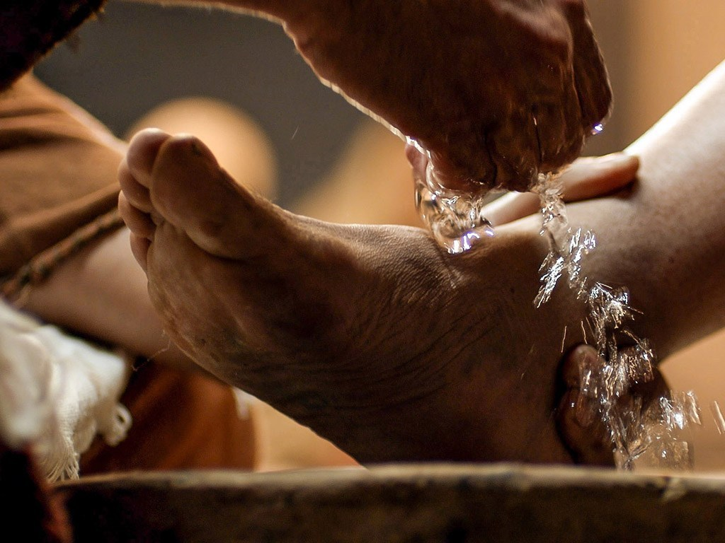

Slide 16
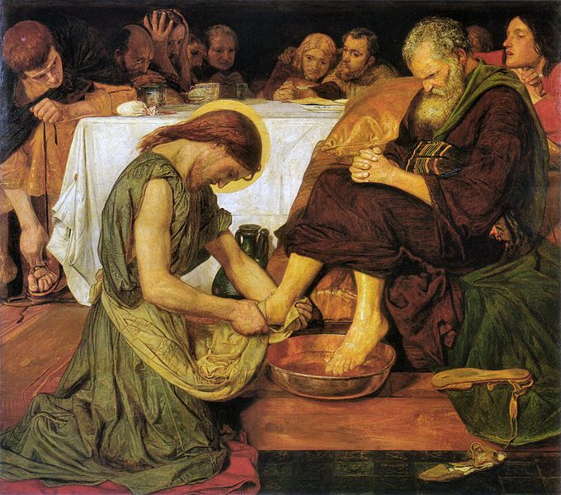

Slide 17
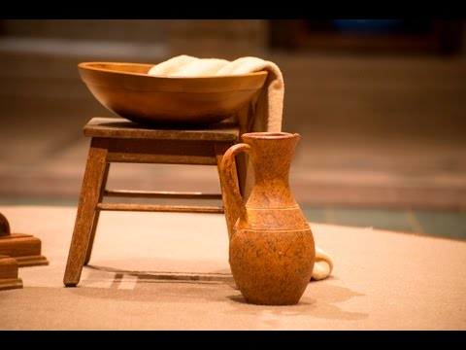

Slide 18
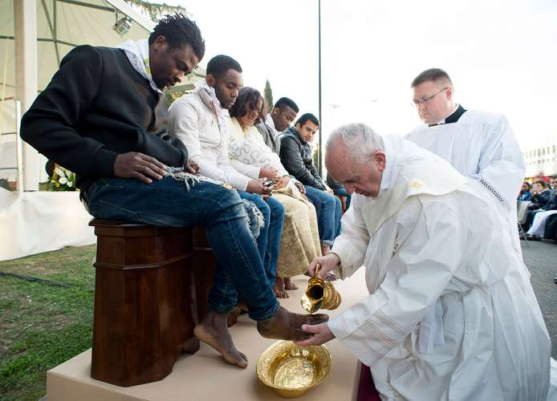

Slide 19
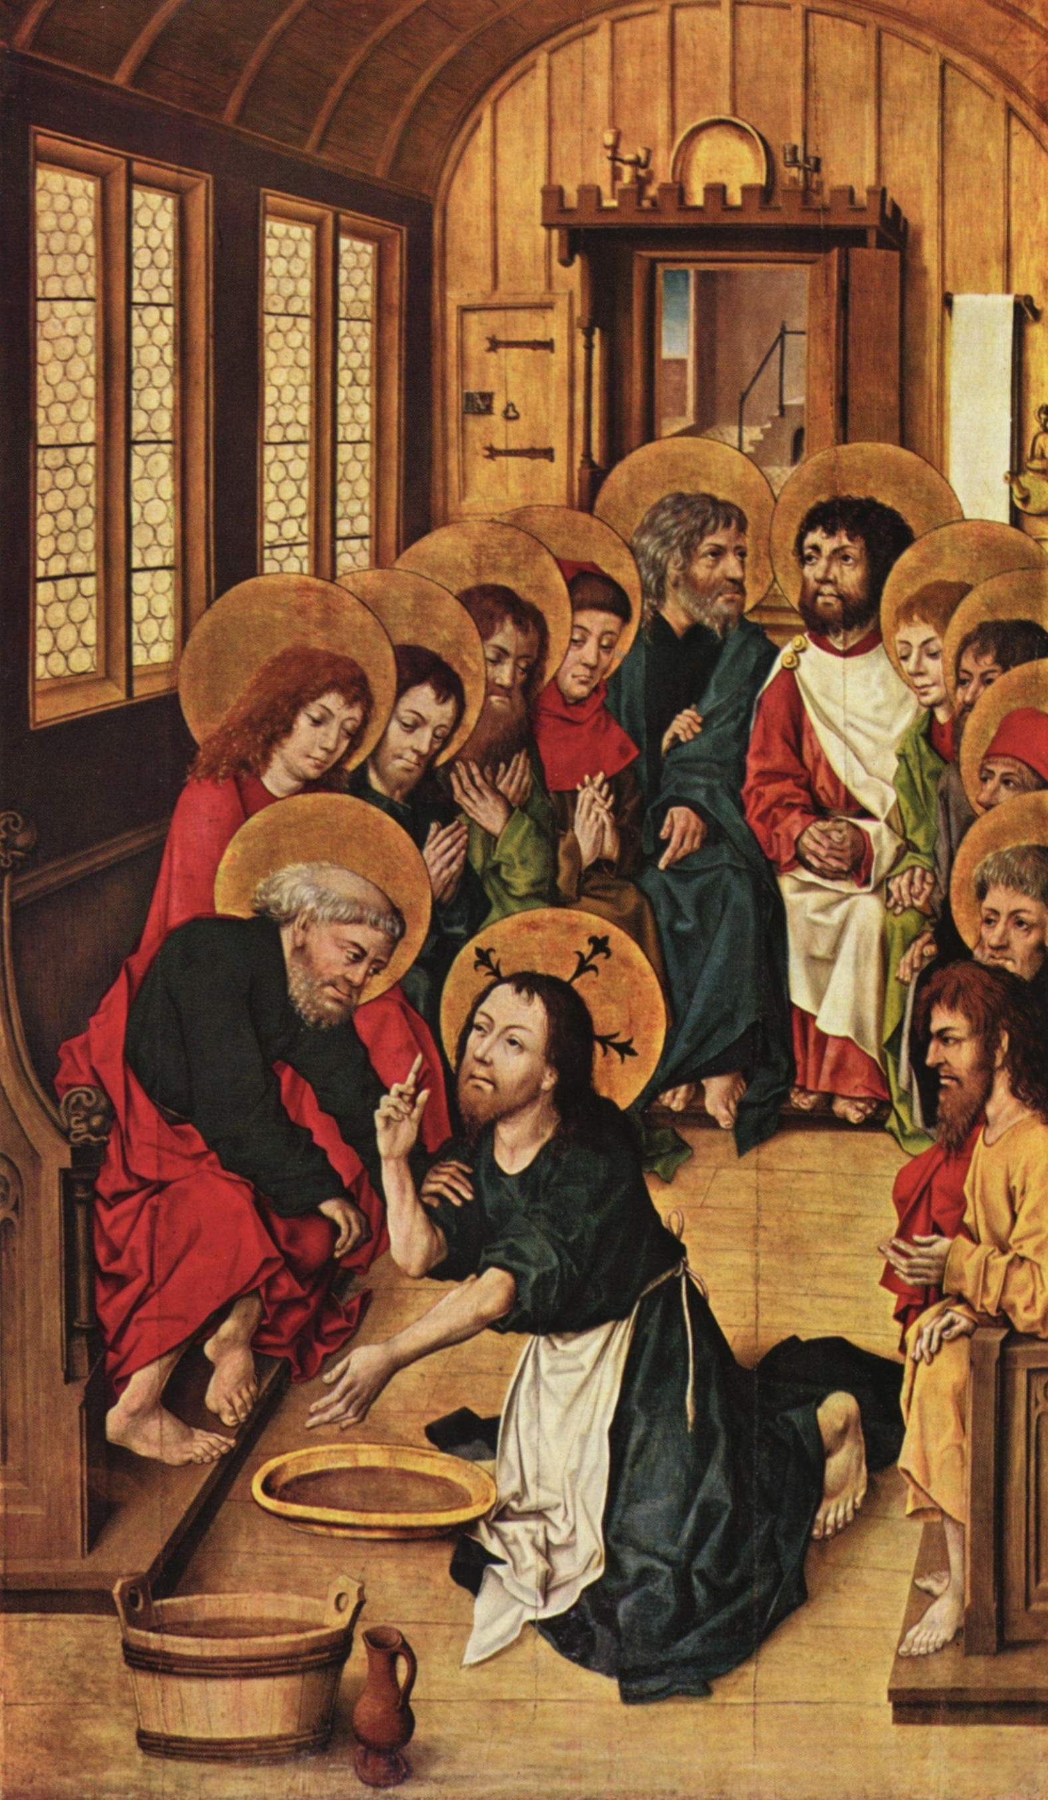

Slide 20
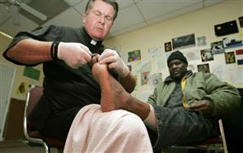

Slide 21
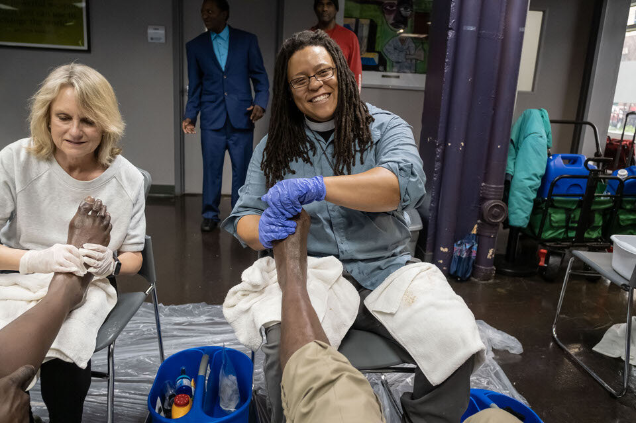

Slide 22
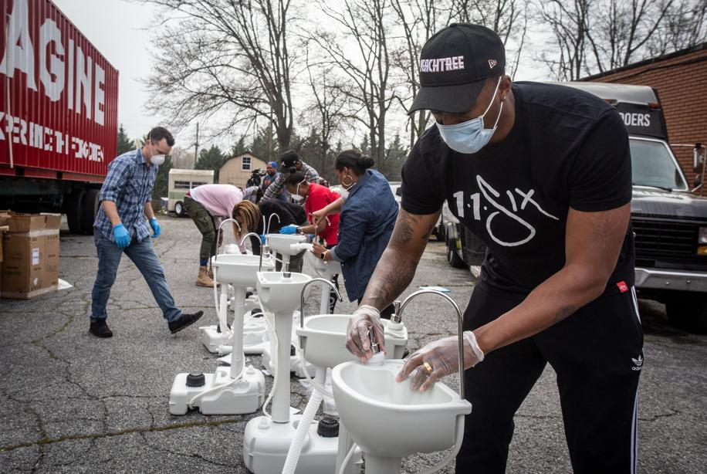

Slide 23
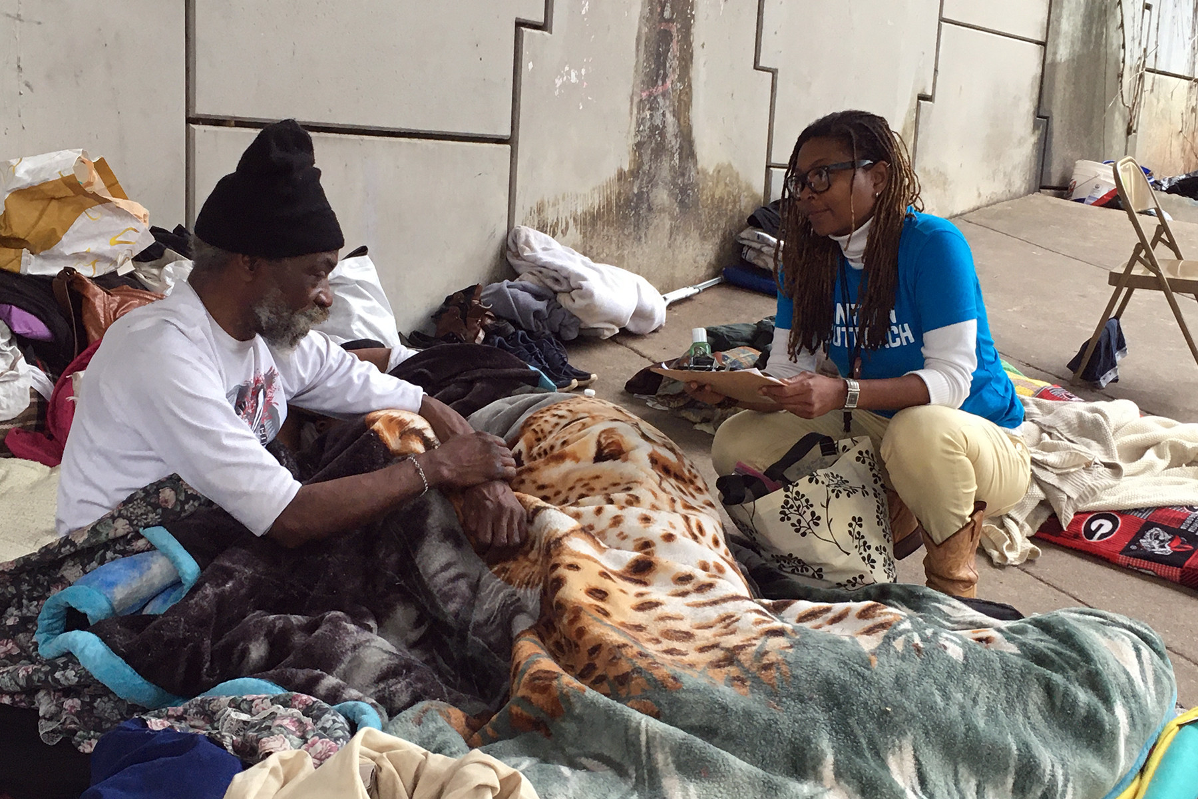

Slide 24
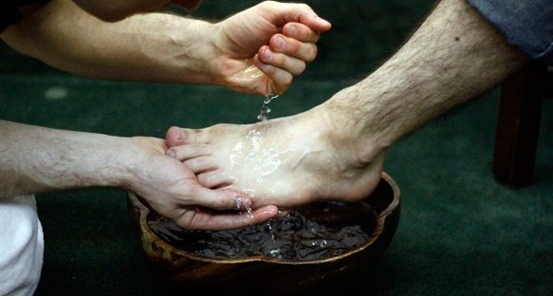

Slide 25
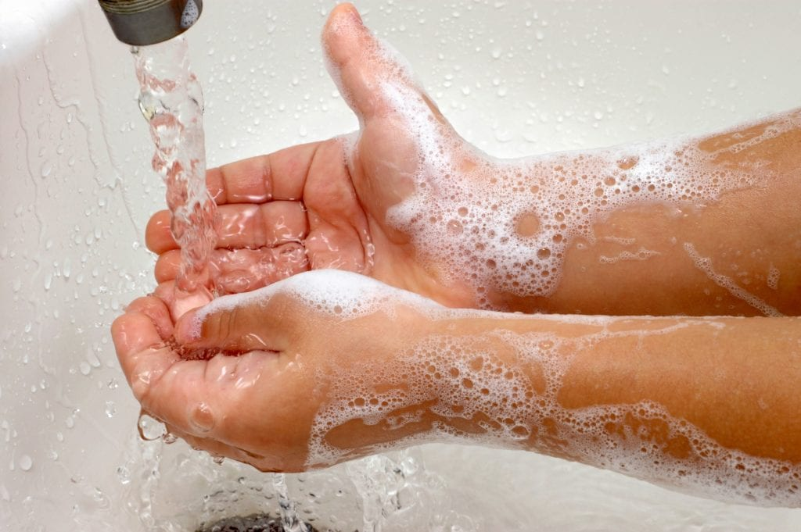

Slide 26
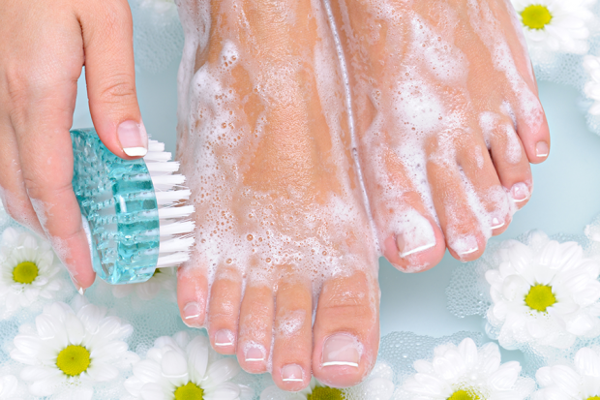

Slide 27
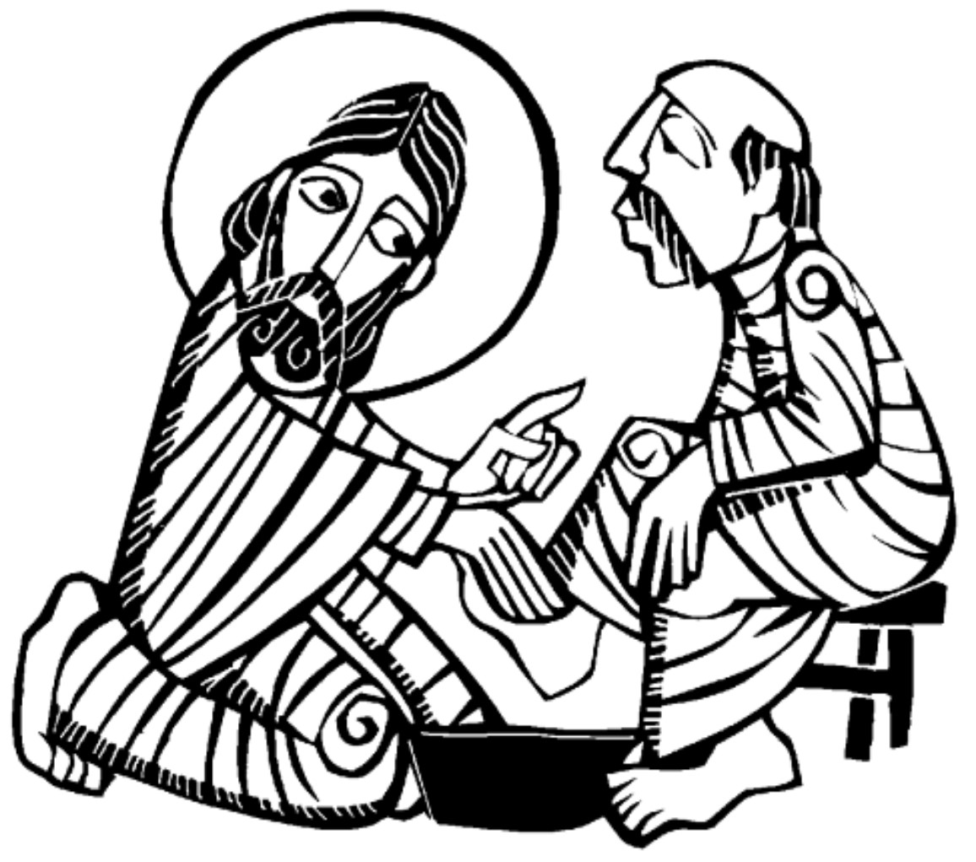

Slide 28
Interlude If Ye Love Me Thomas Tallis

Slide 29
The Nicene Creed
All We believe in one God,
the Father, the Almighty, maker of heaven and earth,
of all that is, seen and unseen.
We believe in one Lord, Jesus Christ,
the only Son of God, eternally begotten of the Father,
God from God, Light from Light,
true God from true God, begotten, not made,
of one Being with the Father.
Through him all things were made.
For us and for our salvation
he came down from heaven:
by the power of the Holy Spirit
he became incarnate from the Virgin Mary,
and was made man. For our sake he was crucified under Pontius Pilate;
he suffered death and was buried.

Slide 30
On the third day he rose again
in accordance with the Scriptures;
he ascended into heaven
and is seated at the right hand of the Father.
He will come again in glory to judge the living and the dead, and his kingdom will have no end.
We believe in the Holy Spirit,
the Lord, the giver of life, who proceeds from the Father and the Son. With the Father and the Son
he is worshiped and glorified.
He has spoken through the Prophets.
We believe in one holy catholic and apostolic Church.
We acknowledge one baptism for the forgiveness of sins.
We look for the resurrection of the dead,
and the life of the world to come. Amen.

Slide 31
Prayers of the People
While the entire Quran is a source of healing, there are six verses that address healing and are referred to as Ayat Ash-Shifa or the Quranic Verses of Healing.
And [God] shall heal the breast of the believers. (at-Tawba, 9:14)
وَيَشْفِ صُدُورَ قَوْمٍ مُؤْمِنِينَ
*****
Mankind there has come to you a guidance from your Lord and a healing for (the diseases) in your hearts, and for those who believe a guidance and a mercy. (Yunus, 10:57)
يَا أَيُّهَا النَّاسُ قَدْ جَاءَتْكُمْ مَوْعِظَةٌ مِنْ رَبِّكُمْ وَشِفَاءٌ لِمَا فِي الصُّدُورِ وَهُدًى وَرَحْمَةٌ لِلْمُؤْمِنِينَ
*****
There issues from within the bodies of the bee a drink of varying colors wherein is healing for mankind. (an-Nahl, 16:69)
يَخْرُجُ مِنْ بُطُونِهَا شَرَابٌ مُخْتَلِفٌ أَلْوَانُهُ فِيهِ شِفَاءٌ لِلنَّاسِ ۗ إِنَّ فِي ذَٰلِكَ لَآيَةً لِقَوْمٍ يَتَفَكَّرُونَ
*****

Slide 32
And We sent down in the Quran such things that have healing and mercy for the believers (al-Isra, 17:82)
وَنُنَزِّلُ مِنَ الْقُرْآنِ مَا هُوَ شِفَاءٌ وَرَحْمَةٌ لِلْمُؤْمِنِينَ ۙ وَلَا يَزِيدُ الظَّالِمِينَ إِلَّا خَسَارًا
*****
And when I am ill, it is [God] who cures me.” (Ash-Shu’ara (The Poets: 26:80) (A supplication of Prophet Abraham)
وَإِذَا مَرِضْتُ فَهُوَ يَشْفِينِ
*****
And declare (O Muhammad) that [the Quran] is a guidance and healing for the believers. (al-Fussilat, 41:44)
قُلْ هُوَ لِلَّذِينَ آمَنُوا هُدًى وَشِفَاءٌ
*****

Slide 33
Healing from Coronavirus
Source of healing, Cast the light of health and well-being On those who’ve been exposed to coronavirus, Those who have contracted the disease, And those — God forbid — who contract the disease in the future. Bless them, protect them and bring them speedily to full recovery. Bless all who are ill With healing of body, Healing of soul And healing of spirit.
.ברוך אתה ה’, מקור חיים Baruch atah Adonai, m’kor chayim. Blessed are You Adonai, Source of life.

Slide 34
Traveler’s Prayer in a Time of Pandemic
May it be Your will, Our God, God of our fathers and mothers, That we go in peace And return in peace, Safe from the ancient hazards of travel – Enemies, thieves, ambushes and wild beasts – And safe from modern perils – Plane crashes and traffic wrecks, Scammers and con artists, Infectious disease and quarantine – So that our travel serves it highest purpose, And we reach our destination and return home In joy, life and health. Grant us grace in Your eyes And in the eyes of all whom we meet.
.ברוך אתה ה’, שומע תפלה Baruch atah Adonai, shomea t’filah. Blessed are You Adonai, Who hears prayer.

Slide 35
Coronavirus: A Prayer for Medical Scientists
God of wisdom, Bless medical scientists and researchers around the world With insight and skill, dedication and fortitude, As they combat coronavirus, So that their work yields knowledge and understanding, Speedily finding a vaccine, treatments and deterrents to its spread.
Source of life, Grant public health and government officials The strength to act swiftly and decisively, With compassion and understanding, In service to humankind, Fighting this outbreak And the other diseases that still plague the planet, Diseases threatening the lives of our brothers and sisters, Nations and communities, Young and old.
Rock of Ages, Bring an end to disease and suffering, So that all may know Your compassion and Your grace.
.ברוך אתה ה’, רופא כל בשר, ומפליא לעשות Baruch atah Adonai, rofeh kol basar, u’mafliah la’asot. Praised are You Adonai, healer of flesh, maker of wonders.

Slide 36
Pope Francis’s prayer to Mary during coronavirus pandemic
O Mary, you always shine on our path as a sign of salvation and of hope. We entrust ourselves to you, Health of the Sick, who at the cross took part in Jesus’ pain, keeping your faith firm. You, Salvation of the Roman People, know what we need, and we are sure you will provide so that, as in Cana of Galilee, we may return to joy and to feasting after this time of trial.

Slide 37
Help us, Mother of Divine Love, to conform to the will of the Father and to do as we are told by Jesus, who has taken upon himself our sufferings and carried our sorrows to lead us, through the cross, to the joy of the resurrection. Amen.
Under your protection, we seek refuge, Holy Mother of God. Do not disdain the entreaties of we who are in trial, but deliver us from every danger, O glorious and blessed Virgin. Amen
[Translation done by Catholic News Service of the prayer Pope Francis recited by video March 11 for a special Mass and act of prayer asking Mary to protect Italy and the world during of the coronavirus pandemic.]

Slide 38
I ask your prayers for God’s people throughout the world; for this gathering; and for all ministers and people. Especially for Michael our Presiding Bishop, for Rob, Don, and Paul our Bishops, for Keith and Neil our Bishops retired. In the Anglican Communion we pray for pray for the Diocese of Milwaukee and The Rt Rev’d Steven Miller; the Diocese of West Virginia and The Rt Rev’d Willam M. Klusmeyer; and the Diocese of Western Izon (Nigeria) and The Rt Rev’d Edafe Emamezi. In our Diocese of Atlanta we pray for all congregations seeking new or renewed direction, for Grace-Calvary, Clarkesville and for The Bishop and people of our companion and partner, the Diocese of Cape Coast. Pray for the Church.
Silence

Slide 39
I ask your prayers for peace; for goodwill among nations; and for the well-being of all people: for Donald our President, Brian our Governor, Fred our Mayor and Philip our County Commission Chairman. Pray for justice and peace.
Silence
I ask your prayers for the poor, the sick, the hungry, the oppressed, and those in prison, especially Carol Blow, HD Cannington, Jack Hall, Dan Jubelt, Bob Lyle, Cecil Miner, and Jane Symmes. Pray for those in any need or trouble. Silence
I ask your prayers for all those places torn by human strife and violence and especially those whose service puts them in harm’s way.
Silence

Slide 40
I ask your prayers for Doug Adkins and our Parish Commission on Ministry: Terry Blum, Rick Crowne, OJ Booker, and Anna Marett. We pray also for those who brought their prayers and petitions in our church and in a register. We pray for all who seek God, or a deeper knowledge of God. Pray that they may find and be found by God.
Silence
I ask your prayers for the departed especially John Leslie Prichard, father to Kelly Freyer and grandfather to Reese and Susie and Cecil Thomas Miner, mother to Peggy Hawkins. Pray for those who have died.
Silence
I ask your prayers for those celebrating Birthdays or Anniversaries this week, especially Marsha Schmalhorst.
Silence

Slide 41
Praise God for those in every generation in whom Christ has been honored. Pray that we may have grace to glorify Christ in our own day.
Silence
Officiant O Lord our God, accept the fervent prayers of your people; in the multitude of your mercies, look with compassion upon us and all who turn to you for help; for you are gracious, O lover of souls, and to you we give glory, Father, Son, and Holy Spirit, now and for ever. Amen.

Slide 42
Psalm 22
All 1 My God, my God, why have you forsaken me? *
and are so far from my cry
and from the words of my distress?
2 O my God, I cry in the daytime, but you do not answer; *
by night as well, but I find no rest.
3 Yet you are the Holy One, *
enthroned upon the praises of Israel.
4 Our forefathers put their trust in you; *
they trusted, and you delivered them.
5 They cried out to you and were delivered; *
they trusted in you and were not put to shame.
6 But as for me, I am a worm and no man, *
scorned by all and despised by the people.
7 All who see me laugh me to scorn; *
they curl their lips and wag their heads, saying,

Slide 43
8 “He trusted in the Lord; let him deliver him; *
let him rescue him, if he delights in him.”
9 Yet you are he who took me out of the womb, *
and kept me safe upon my mother’s breast.
10 I have been entrusted to you ever since I was born; *
you were my God when I was still in my mother’s womb.
11 Be not far from me, for trouble is near, *
and there is none to help.
12 Many young bulls encircle me; *
strong bulls of Bashan surround me.
13 They open wide their jaws at me, *
like a ravening and a roaring lion.
14 I am poured out like water; all my bones are out of joint; *
my heart within my breast is melting wax.

Slide 44
15 My mouth is dried out like a pot-sherd;
my tongue sticks to the roof of my mouth; *
and you have laid me in the dust of the grave.
16 Packs of dogs close me in, and gangs of evildoers circle around me; *
they pierce my hands and my feet; I can count all my bones.
17 They stare and gloat over me; *
they divide my garments among them; they cast lots for my clothing.
18 Be not far away, O Lord; *
you are my strength; hasten to help me.
19 Save me from the sword, *
my life from the power of the dog.
20 Save me from the lion’s mouth, *
my wretched body from the horns of wild bulls.
21 I will declare your Name to my brethren; *
in the midst of the congregation I will praise you.
22 Praise the Lord, you that fear him; *
stand in awe of him, O offspring of Israel;
all you of Jacob’s line, give glory.

Slide 45
23 For he does not despise nor abhor the poor in their poverty;
neither does he hide his face from them; *
but when they cry to him he hears them.
24 My praise is of him in the great assembly; *
I will perform my vows in the presence of those who worship him.
25 The poor shall eat and be satisfied,
and those who seek the Lord shall praise him: *
“May your heart live for ever!”
26 All the ends of the earth shall remember and turn to the Lord, *
and all the families of the nations shall bow before him.
27 For kingship belongs to the Lord; *
he rules over the nations.
28 To him alone all who sleep in the earth bow down in worship; *
all who go down to the dust fall before him.
29 My soul shall live for him; my descendants shall serve him; *
they shall be known as the Lord’s for ever.
30 They shall come and make known to a people yet unborn *
the saving deeds that he has done.

Slide 46
A Solemn Prayer Over the People
Officiant Let us bow down before the Lord
Almighty God, we pray you graciously to behold this your family, for whom our Lord Jesus Christ was willing to be betrayed, and given into the hands of sinners, and to suffer death upon the cross; who lives and reigns for ever and ever. Amen.

