Slide 1
Opening Devotions
In the Name of the Creator, and of the Redeemer, and of the Sanctifier. Amen.
Lord, have mercy. Christ, have mercy. Lord, have mercy.
Officiant and People
Our Father, who art in heaven, hallowed be thy Name, thy kingdom come, thy will be done, on earth as it is in heaven. Give us this day our daily bread. And forgive us our trespasses, as we forgive those who trespass against us. And lead us not into temptation, but deliver us from evil.
V. We will glory in the cross of our Lord Jesus Christ: R. In whom is our salvation, our life and resurrection.
Let us pray.
(Silence)
O God the Bestower of our salvation, we ask that you quiet our hearts in joyful contemplation of your mighty acts, through which you have gifted us with life and immortality; through Jesus Christ our Lord. Amen

Slide 2
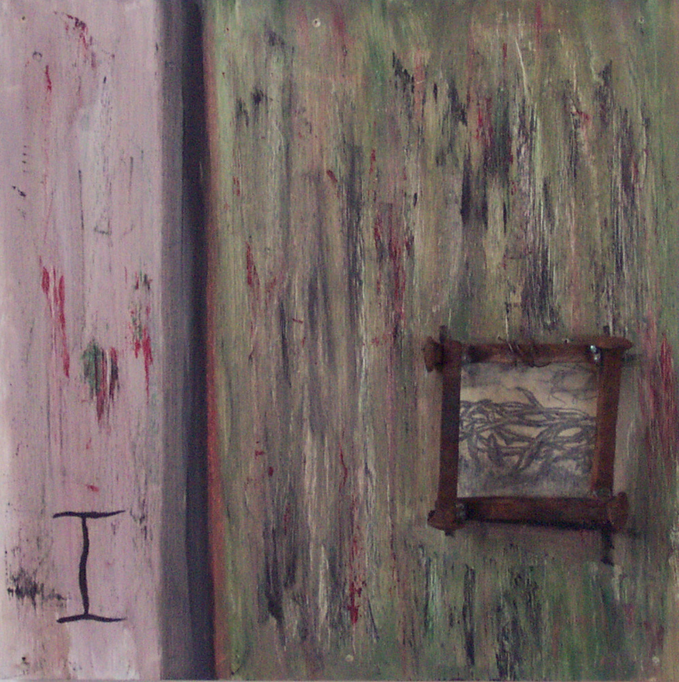
First Station Jesus is condemned to death We adore you, O Christ, and we bless you:
Because by your holy cross you have redeemed the world.
When morning came, all the chief priests and the elders of the people conferred together against Jesus in order to bring about his death. They bound him, led him away, and handed him over to Pilate the governor. Pilate said to them, “What should I do with Jesus who is called the Messiah?” All of them said, “Let him be crucified!” Then he asked, “Why, what evil has he done?” But they shouted all the more, “Let him be crucified!” So when Pilate saw that he could do nothing, but rather that a riot was beginning, he flogged Jesus, and handed him over to be crucified.
V. God spared not even God’s own Self: R. Joining us in suffering of body and spirit.
Let us pray. (Silence)
God the Guide, take us with you along that holy way you took once to your death. Let us walk beside you with our minds, our memories, and our reluctant hearts, and grant that the way of the cross be for us the way of life and peace. Amen.
Holy God, Holy and Mighty, Holy Immortal One, Have mercy upon us.

Slide 3
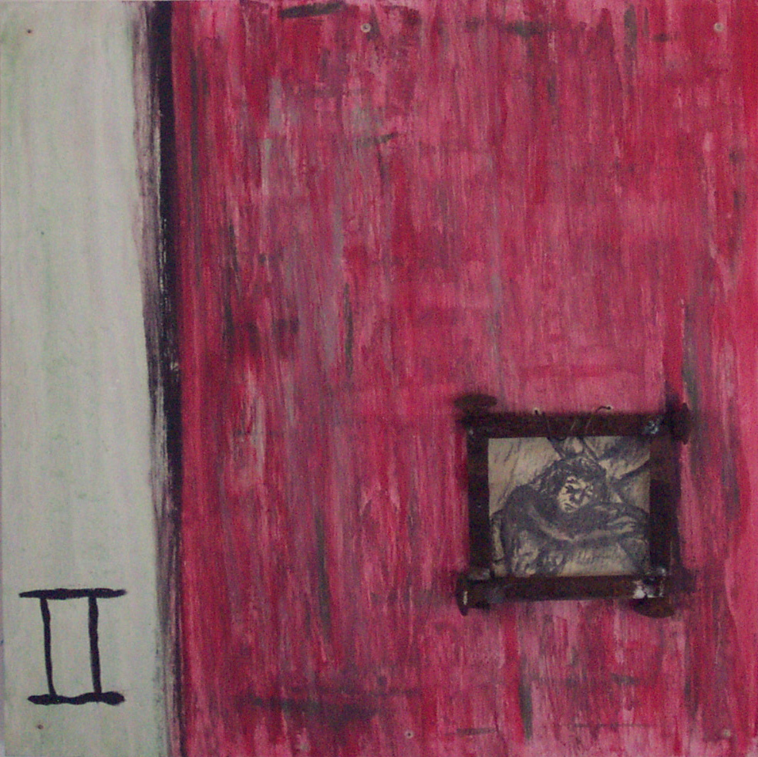
Second Station Jesus takes up his cross We adore you, O Christ, and we bless you:
Because by your holy cross you have redeemed the world.
Then the soldiers of the governor took Jesus into the governor’s headquarters, and they gathered the whole cohort around him. They stripped him and put a scarlet robe on him, and after twisting some thorns into a crown, they put it on his head. They put a reed in his right hand and knelt before him and mocked him, saying, "Hail, King of the Jews!" They spat on him, and took the reed and struck him on the head. After mocking him, they stripped him of the robe and put his own clothes on him. Then they led him away to crucify him. V. The Lord has taken on the iniquity of us all: R. The transgression of my people struck down the Most Merciful.
Let us pray. (Silence) God the Invulnerable, you willingly endured the agony and shame of the cross. Lend us courage in our own trials, in the name of the one who lives and reigns for ever and ever. Amen. Holy God,
Holy and Mighty,
Holy Immortal One,
Have mercy upon us.

Slide 4
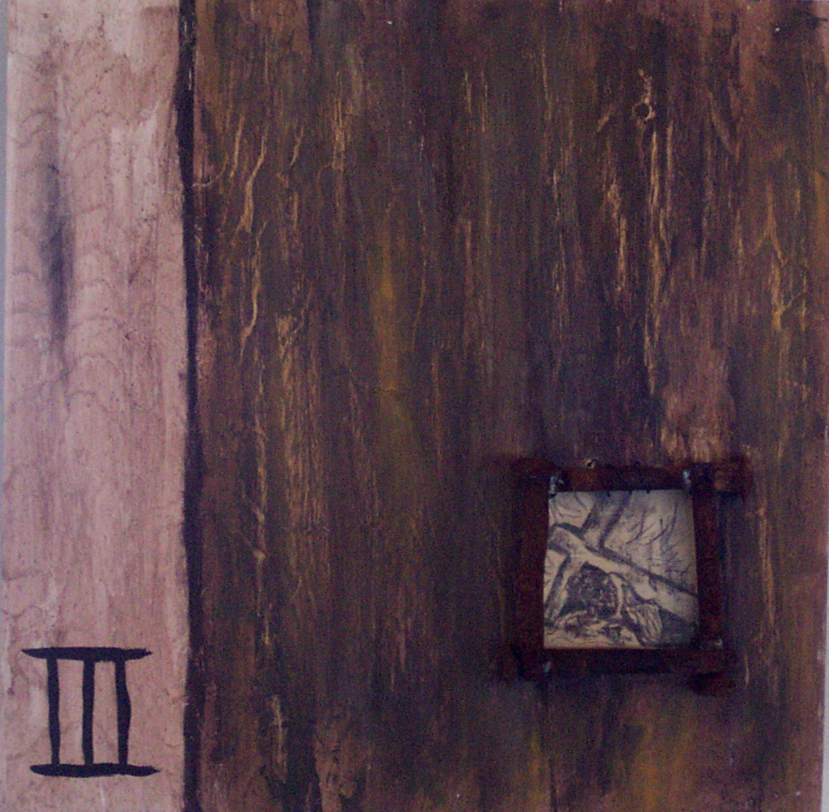
Third Station Jesus falls the first time We adore you, O Christ, and we bless you:
Because by your holy cross you have redeemed the world.
Christ Jesus, though he was in the form of God, did not count equality with God a thing to be grasped; but emptied himself, taking the form of a servant, and was born in human likeness. And being found in human form he humbled himself and became obedient unto death, even death on a cross. Therefore God has highly exalted him, and bestowed on him the name which is above every name. Come, let us bow down, and bend the knee, and kneel before the Lord our Maker, for he is the Lord our God. V. Surely he has borne our griefs: R. And carried our sorrows.
Let us pray. (Silence) O God the Protecting Friend, you above all understand that we are plagued by many deep fears, and that we are frail and cannot always stand upright. Enable us to feel your guiding hand in all dangers, and your support through all temptations; through Jesus Christ our Lord. Amen. Holy God, Holy and Mighty, Holy Immortal One,
Have mercy upon us.

Slide 5
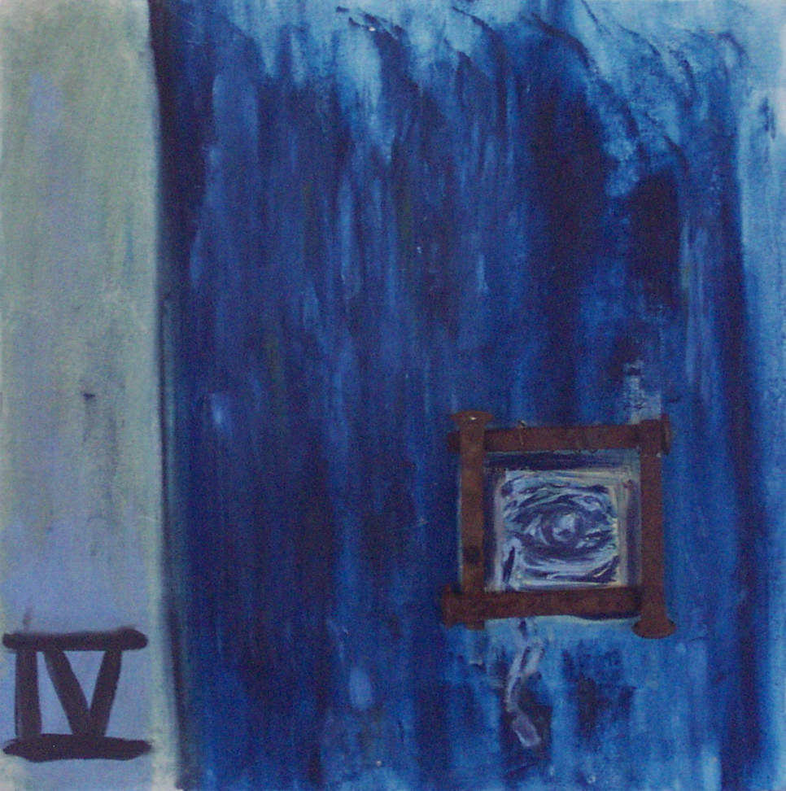
Fourth Station Jesus meets his afflicted mother We adore you, O Christ, and we bless you:
Because by your holy cross you have redeemed the world.
To what can I liken you, to what can I compare you, O daughter of Jerusalem? What likeness can I use to comfort you, O virgin daughter of Zion? For vast as the sea is your ruin. Blessed are those who mourn, for they shall be comforted. The Lord will be your everlasting light, and your days of mourning shall be ended. V. A sword will pierce your own soul also: R. And fill your heart with bitter pain.
Let us pray. (Silence) O God the Exceedingly Compassionate, in the passion of your Son a sword of grief pierced Blessed Mary his mother. Bestow on your Church this same heartbreak at injustice, that it may be made worthy to share in the joys of Jesus’ resurrection. Amen. Holy God, Holy and Mighty, Holy Immortal One,
Have mercy upon us.

Slide 6
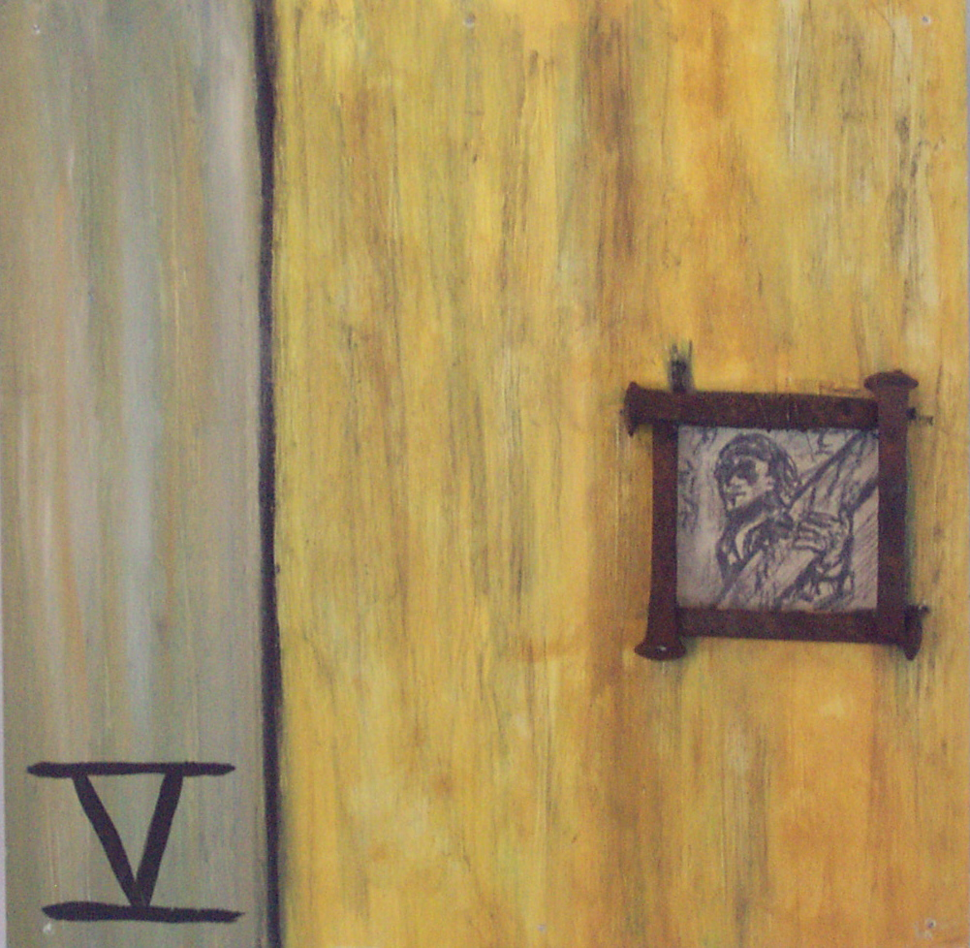
Fifth Station The cross is laid on Simon of Cyrene We adore you, O Christ, and we bless you:
Because by your holy cross you have redeemed the world.
As they led Jesus away, they came upon a man of Cyrene, Simon by name, who was coming in from the country, and laid on him the cross to carry it behind Jesus. “If you wish to come after me, you must first deny your very self, carry what deals you death, and follow me.” “Take my yoke upon you, and learn from me; for my yoke is easy, and my burden is light.” V. Those who do not follow me, facing that which destroys them: R. Cannot be my disciples.
Let us pray. (Silence) God the Generous, who became flesh not to be served but to serve: Bless all who give themselves to the service of others, ministering to the suffering, the friendless, and the needy, for the love of the One whose holy cross made hope possible. Amen. Holy God, Holy and Mighty, Holy Immortal One, Have mercy upon us.

Slide 7
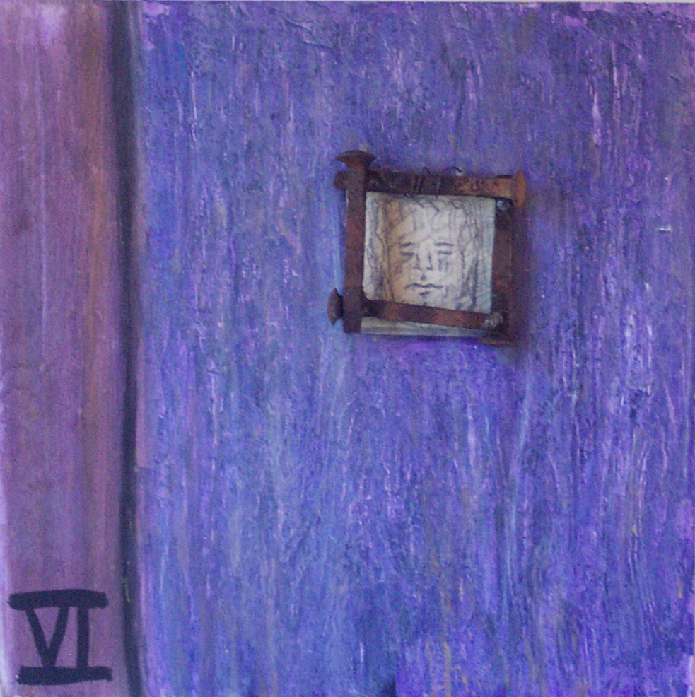
Sixth Station A woman wipes the face of Jesus We adore you, O Christ, and we bless you:
Because by your holy cross you have redeemed the world.
We have seen him without beauty or majesty, nothing in his appearance that we should desire him. He was despised and rejected; a man of sorrows, and acquainted with grief; and as one from whom others hide their faces, he was despised, and we held him of no account. His face was marred beyond human semblance, and his form beyond that of mortals. But he was wounded for our transgressions, crushed for our iniquities; upon him was the punishment that made us whole, and by his bruises we are healed. V. Restore us, O Lord God of hosts: R. Show the light of your countenance, and we shall be saved.
Let us pray. (Silence) O God the Light, who revealed Christ’s glory on the holy mountain, grant that the light of his countenance may strengthen us to bear our cross, and transform us into his likeness, from glory to glory; through Jesus Christ our Lord. Amen. Holy God, Holy and Mighty, Holy Immortal One, Have mercy upon us.

Slide 8
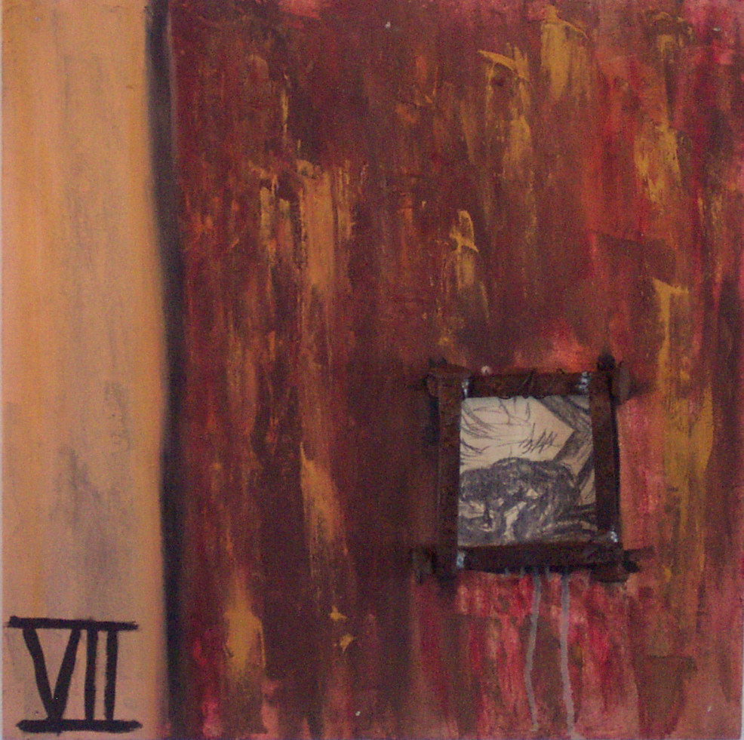
Seventh Station Jesus falls a second time We adore you, O Christ, and we bless you:
Because by your holy cross you have redeemed the world.
Surely he has borne our griefs and carried our sorrows. We, like sheep, have gone astray; we have all turned to our own way; yet the Redeemer has taken on our iniquity. He was oppressed, and he was afflicted, yet he did not open his mouth. V. Here I am, more worm than human: R. The scorn of humanity, an object of ridicule.
Let us pray. (Silence) God the Restorer who brings all to wholeness, in your tender love for the human race you sent your Son our Savior Jesus Christ to take on our nature and to meet us in our suffering. Mercifully grant that we may, in turn, share in his nature and in his resurrection. Amen. Holy God, Holy and Mighty, Holy Immortal One, Have mercy upon us.

Slide 9
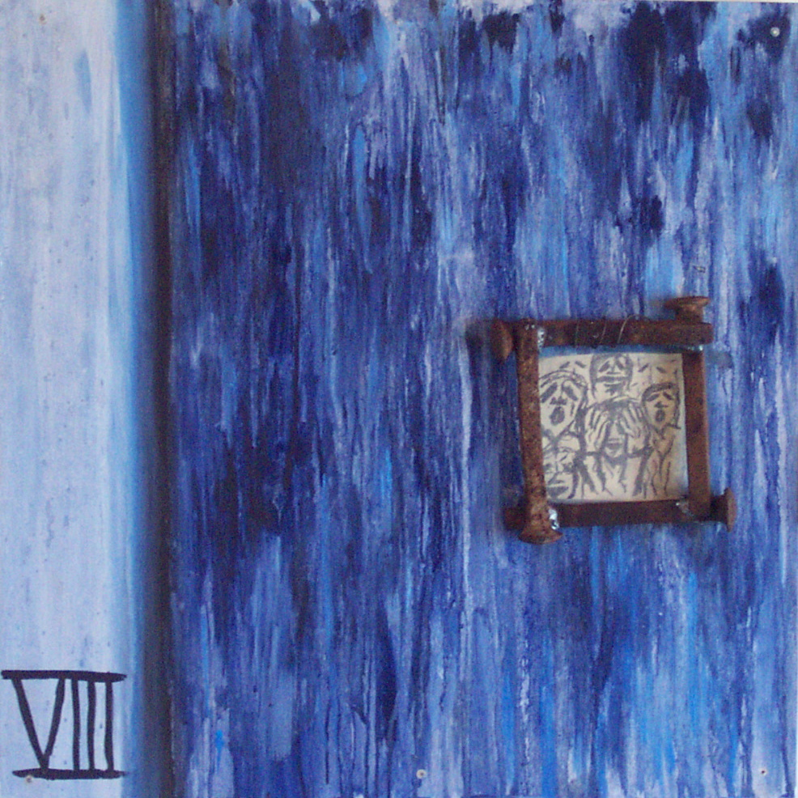
Eighth Station Jesus meets the women of Jerusalem We adore you, O Christ, and we bless you:
Because by your holy cross you have redeemed the world.
A large crowd was following Jesus, many of them women who beat their breasts and wailed for him. But Jesus turned to them and said, “Daughters of Jerusalem, do not weep for me, but weep for yourselves and for your children! The time is coming when it will be said, ‘Blessed are the childless, the wombs that have never given birth and breasts that have never nursed.’ For if they do these things when the wood is green, what will happen when it is dry?” V. Those who sowed with tears: R. Will reap with songs of joy.
Let us pray. (Silence) Teach your Church, O God the Witness, to mourn the sins of which it is guilty, and to repent and forsake them; that, by your pardoning grace, the consequences of our iniquities may be washed away; through Jesus Christ our Lord. Amen. Holy God, Holy and Mighty, Holy Immortal One, Have mercy upon us.

Slide 10
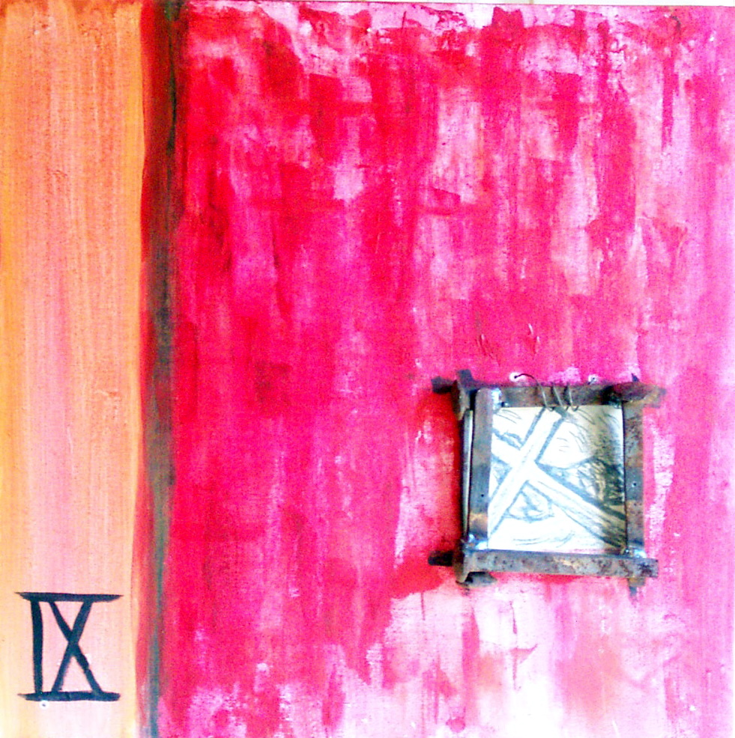
Ninth Station Jesus falls a third time We adore you, O Christ, and we bless you:
Because by your holy cross you have redeemed the world.
The bands of Death encircled me; the messengers of Sheol ambushed me, I was overcome with trouble and sorrow. I walk before you, Adonai, in the land of the living. I believed even when I said, “I am completely crushed,” and in despair said, “No one can be trusted.” V. He was led like a lamb to the slaughter: R. And like a sheep that before its shearers is mute, so he opened not his mouth.
Let us pray. (Silence) God the Purifier, you made an instrument of shameful death to be for us the means of life: May we always be filled with wonder and gratitude that your holiness has made us holy. Amen. Holy God, Holy and Mighty, Holy Immortal One, Have mercy upon us.

Slide 11
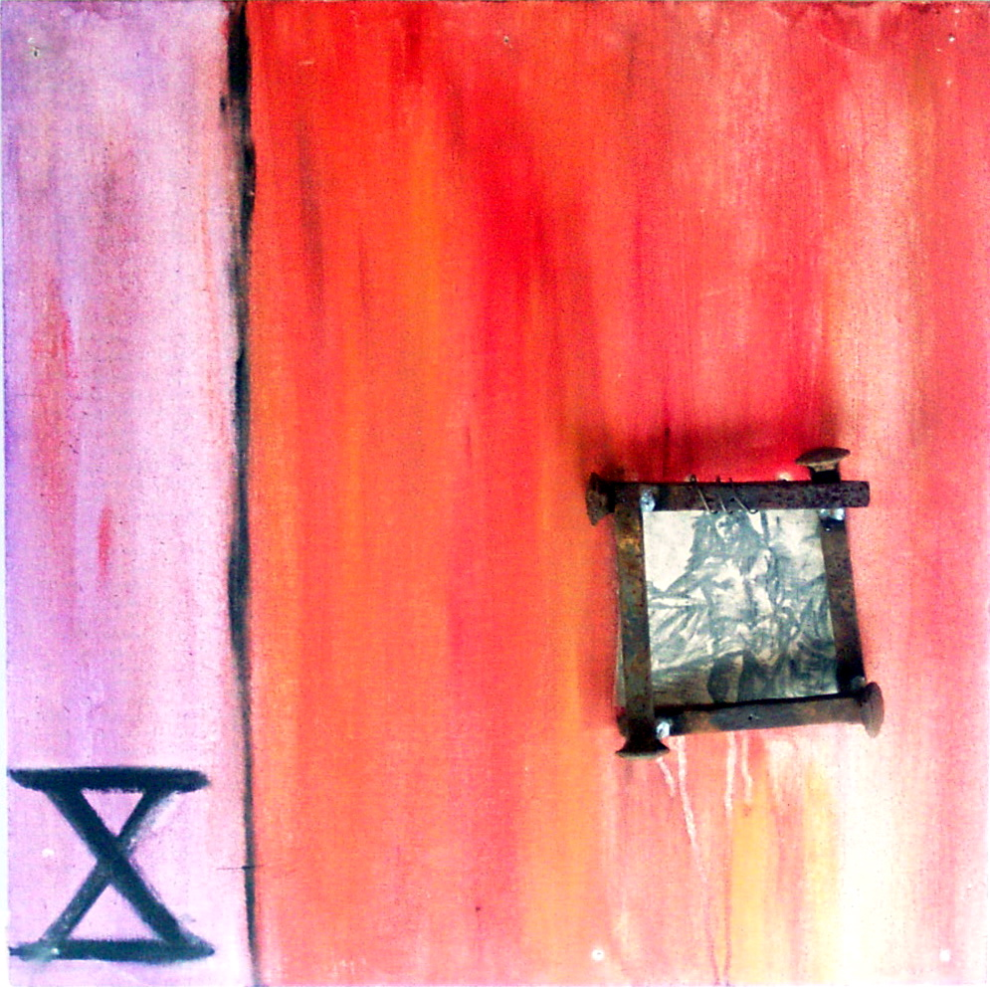
Tenth Station Jesus is stripped of his garments We adore you, O Christ, and we bless you:
Because by your holy cross you have redeemed the world.
When they came to a place called Golgotha (which means the Place of the Skull), they offered him wine mixed with gall; but when he tasted it, he would not drink it. They divided his clothes among themselves by casting lots. V. Insult has broken my heart, and I am weak. I looked for comforters and I found none. R. Rather they put gall in my food, and in my thirst they gave me vinegar to drink.
Let us pray.
(Silence)
God the Magnificent, owner of the universe, we see you stripped of your clothes and your dignity, suffering the insults of those who were ignorant and afraid. Strip us of our desire for power over others, and clothe us instead in garments of love, humility, and compassion. Amen. Holy God, Holy and Mighty, Holy Immortal One, Have mercy upon us.

Slide 12
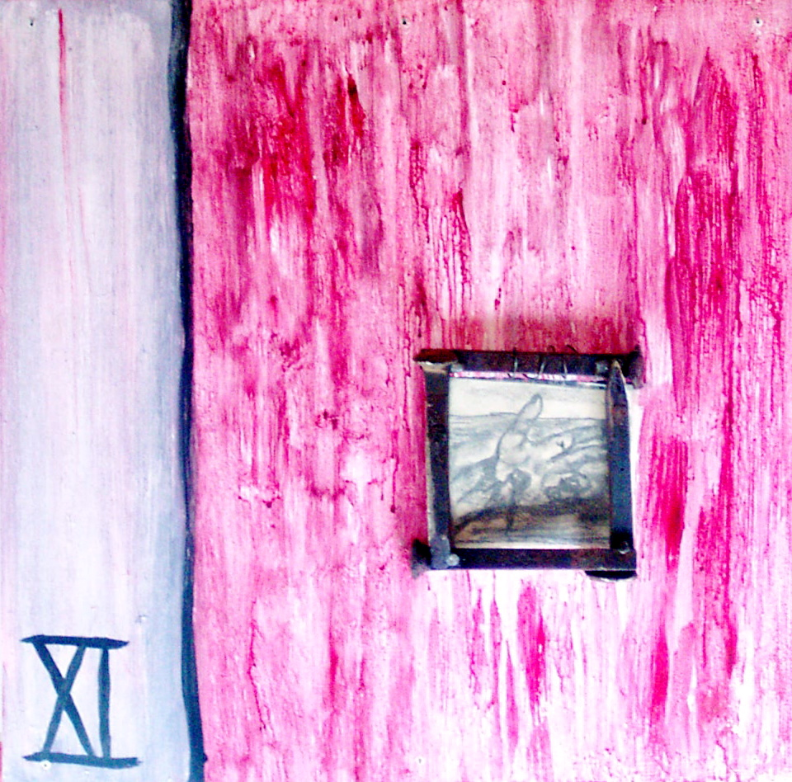
Eleventh Station Jesus is nailed to the Cross We adore you, O Christ, and we bless you:
Because by your holy cross you have redeemed the world.
When they came to the place that is called The Skull, they crucified Jesus there with two criminals, one on his right and one on his left. One of the criminals kept deriding him and saying, “Are you not the Messiah? Save yourself and us!” But the other rebuked him, saying, “We are getting what we deserve for our deeds, but this man has done nothing wrong.” Then he said, “Jesus, remember me when you come into your kingdom.” Jesus replied, “Truly, I tell you, today you will be with me in paradise.” V. They pierce my hands and my feet: R. They stare and gloat over me.
Let us pray. (Silence) God the Gentle, you bled in pain as the nails pierced your flesh. Through the mystery of your love, transform the pain of those who suffer. Amen. Holy God, Holy and Mighty, Holy Immortal One, Have mercy upon us.

Slide 13
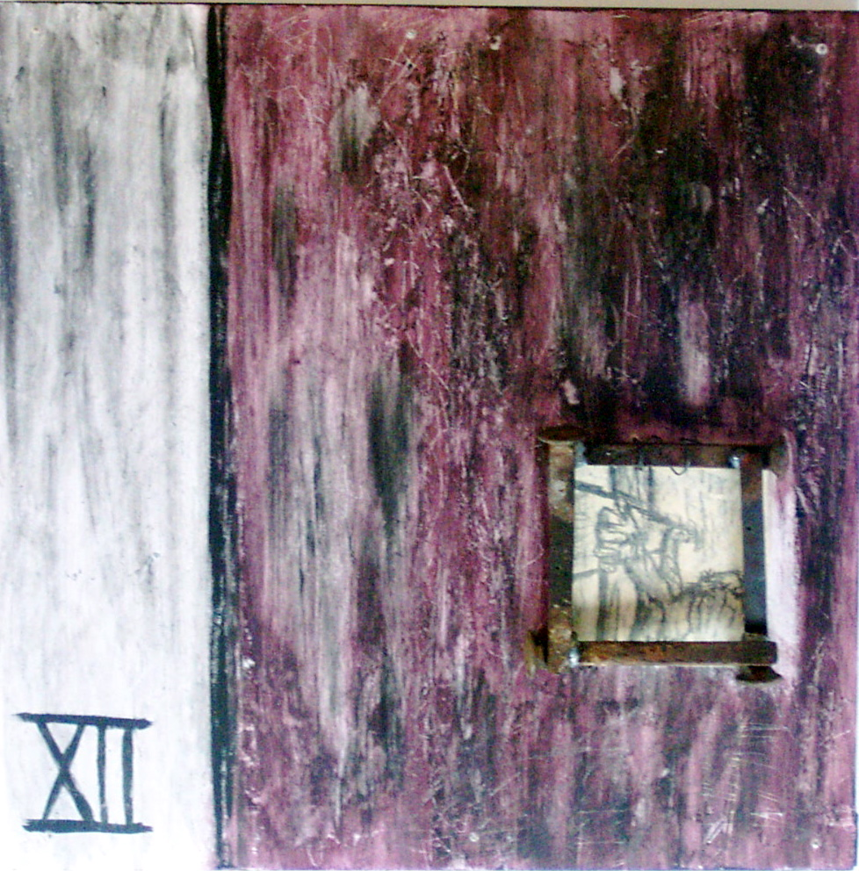
Twelfth Station Jesus dies on the Cross We adore you, O Christ, and we bless you:
Because by your holy cross you have redeemed the world.
It was now about noon, and darkness came over the whole land until three in the afternoon, while the sun’s light failed; and the curtain of the temple was torn in two. Then Jesus, crying with a loud voice, said, “Father, into your hands I commend my spirit.” Having said this, he breathed his last. V. Christ for us became obedient unto death: R. Even death on a cross.
Let us pray. (Silence) O God the Giver of Victory, who by your death and glorious resurrection delivered us from the power of our enemy: help us to die daily to sin, that we may live with you in joy forever. Amen. Holy God, Holy and Mighty, Holy Immortal One, Have mercy upon us.

Slide 14
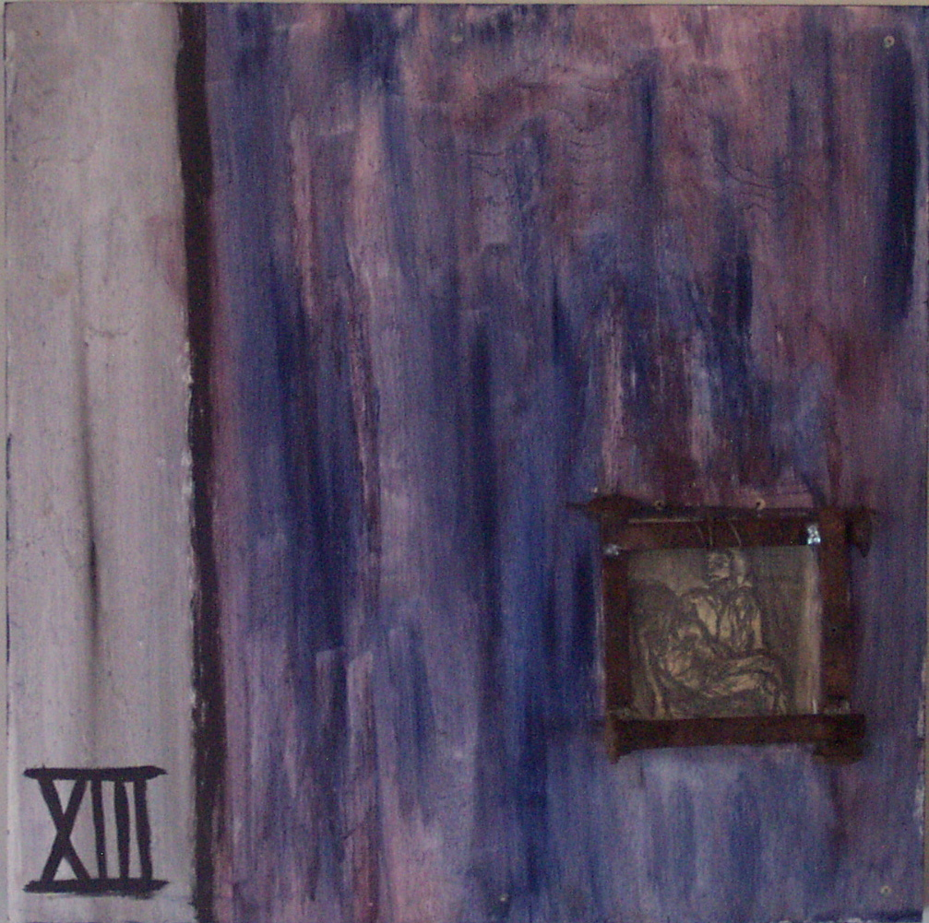
Thirteenth Station The body of Jesus is placed in the arms of his mother We adore you, O Christ, and we bless you:
Because by your holy cross you have redeemed the world.
All you who pass by, behold and see if there is any sorrow like my sorrow. My eyes are spent with weeping; my soul is in tumult; my heart is poured out in grief because of the downfall of my people. V. Her tears run down her cheeks: R. And she has none to comfort her.
Let us pray. (Silence) God the Designer, you know that in this life we endure many separations from those we love. Help us to see that as we participate in your death and resurrection, we learn to let go and see the new thing you are doing. Amen. Holy God, Holy and Mighty, Holy Immortal One, Have mercy upon us.

Slide 15
Fourteenth Station Jesus is laid in the tomb We adore you, O Christ, and we bless you:
Because by your holy cross you have redeemed the world.
When it was evening, there came a rich man from Arimathea, named Joseph, who also was a disciple of Jesus. He went to Pilate and asked for the body of Jesus. Then Pilate ordered it to be given to him. And Joseph took the body, and wrapped it in a clean linen shroud, and laid it in his own new tomb, which he had hewn in the rock; and he rolled a great stone to the door of the tomb. The women who had come with Jesus from Galilee followed, and they saw the tomb and how his body was laid. Then they returned, and prepared spices and ointments. V. You will not abandon me to the grave: R. Nor let your holy one see corruption.
Let us pray.
(Silence) God the Unfailing, it is now for us to take up your work. Make us beacons of your freedom, fostering wisdom and healing in our walk with others. Grant that we continually remember that darkness cannot overcome the light, and that love is stronger than death. Amen.
Holy God, Holy and Mighty, Holy Immortal One, Have mercy upon us.

Slide 16
Concluding Prayers before the Altar
Christ was manifested in the body,
vindicated in the spirit,
seen by angels,
proclaimed among the nations,
believed in throughout the world,
glorified in high heaven.
We adore you, O Christ, and we bless you:
Because by your holy cross you have redeemed the world.
The Lord be with you.
And also with you.
Let us pray.
(Silence)
May God the Source of Peace and Safety bless us, that in us may be found love and humility, obedience and thanksgiving, discipline, gentleness, and peace. Amen.

